Slide 2
Status | Grand Total
Nigerian Refugees | 66899
Urban Refugees | 4466
Asylum-seekers | 1634
Grand Total | 72999
Updated: 31 May 2021; Source: UNHCR; For Feedback or enquiry: nigabim@unhcr.org

Slide 3
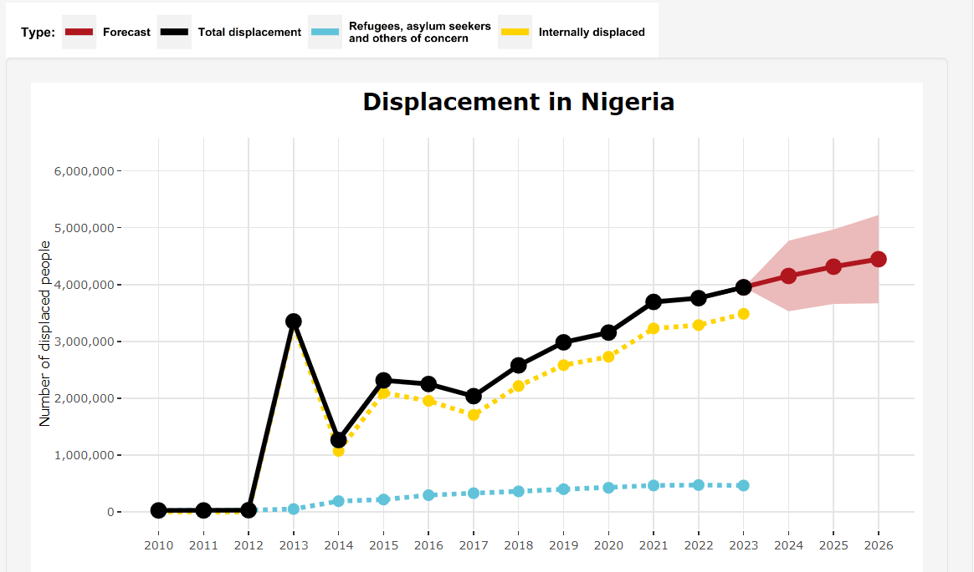
DRC’s Forecasting future displacement
Notes:
https://data.humdata.org/dataset/drc-displacement-forecasts

Slide 4
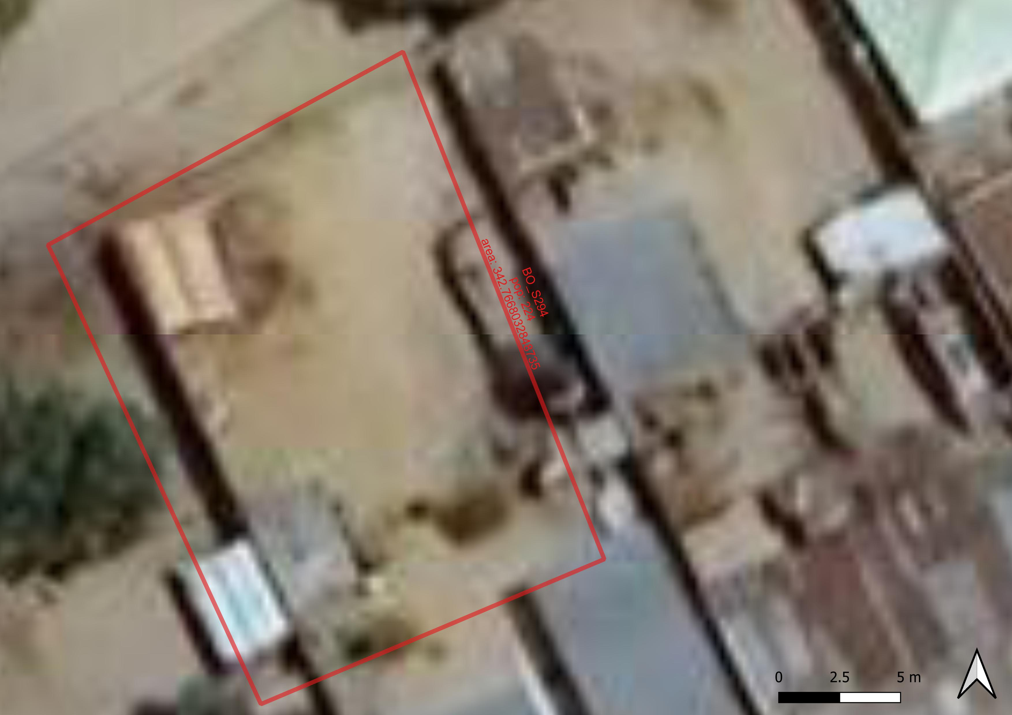
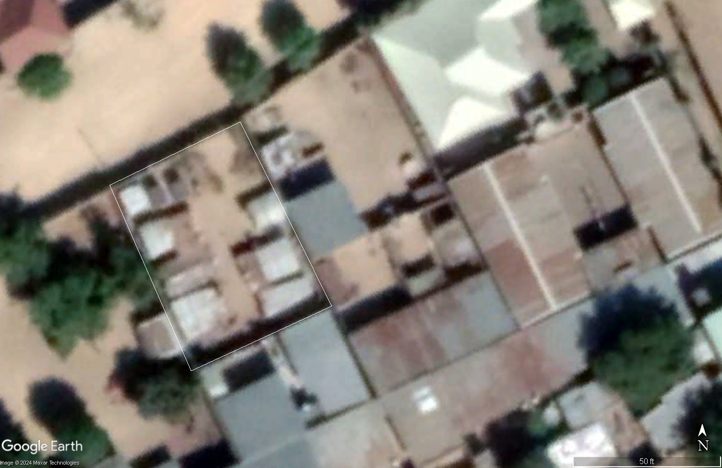
KIRENUWA CAMP(BO_S294 )
Site population:224
Official Site area: 334.61m²
Calculates site area:342.7668 m²

Slide 5
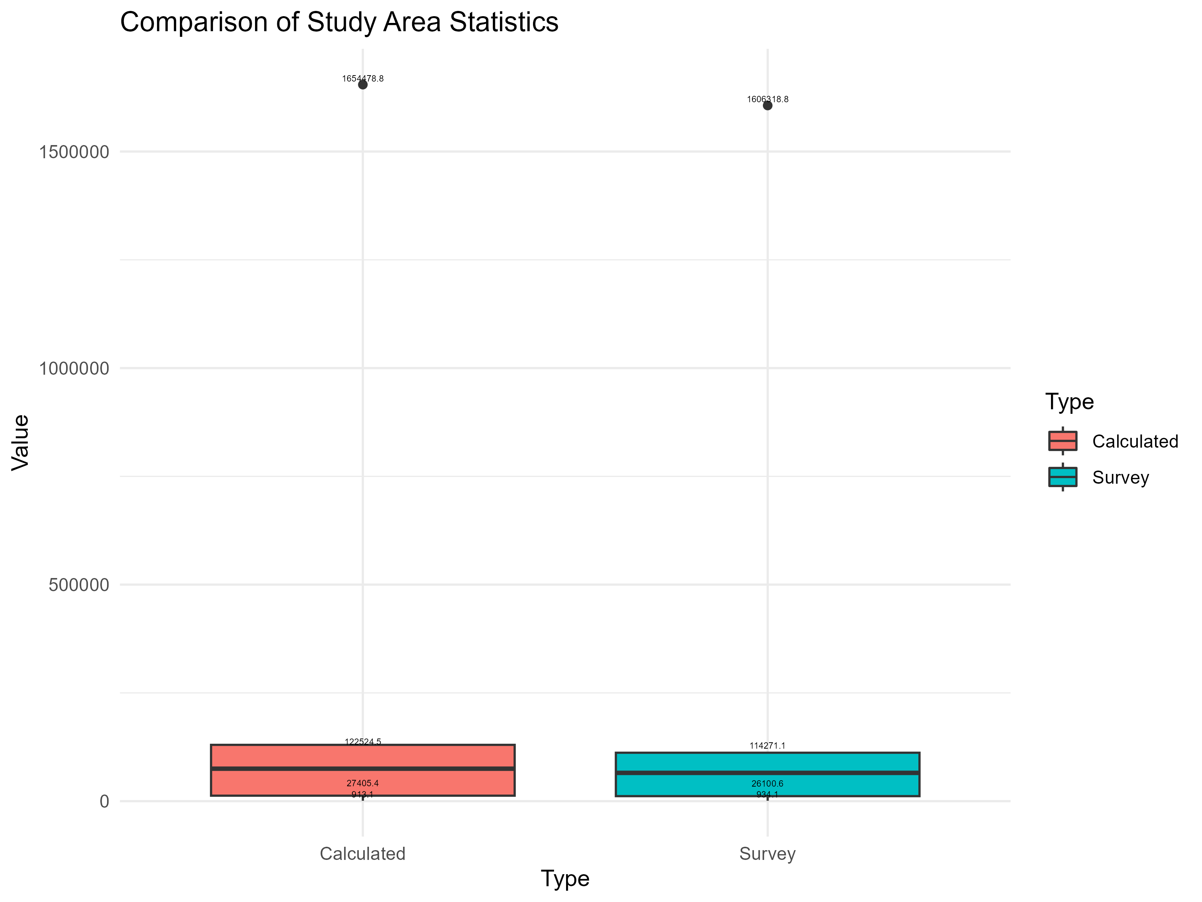

Slide 6
Survey population : Summary statistics
Minimum: 26.0
1st Quadrant: 327.5
Median: 1058.0
Mean: 4134.3
3rd Quadrant: 4575.5
Maximum: 43074.0

Slide 7
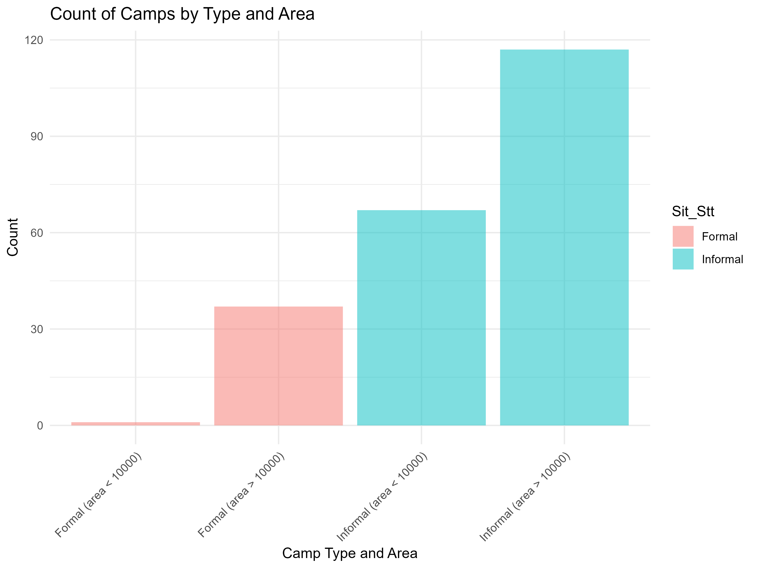

Slide 8
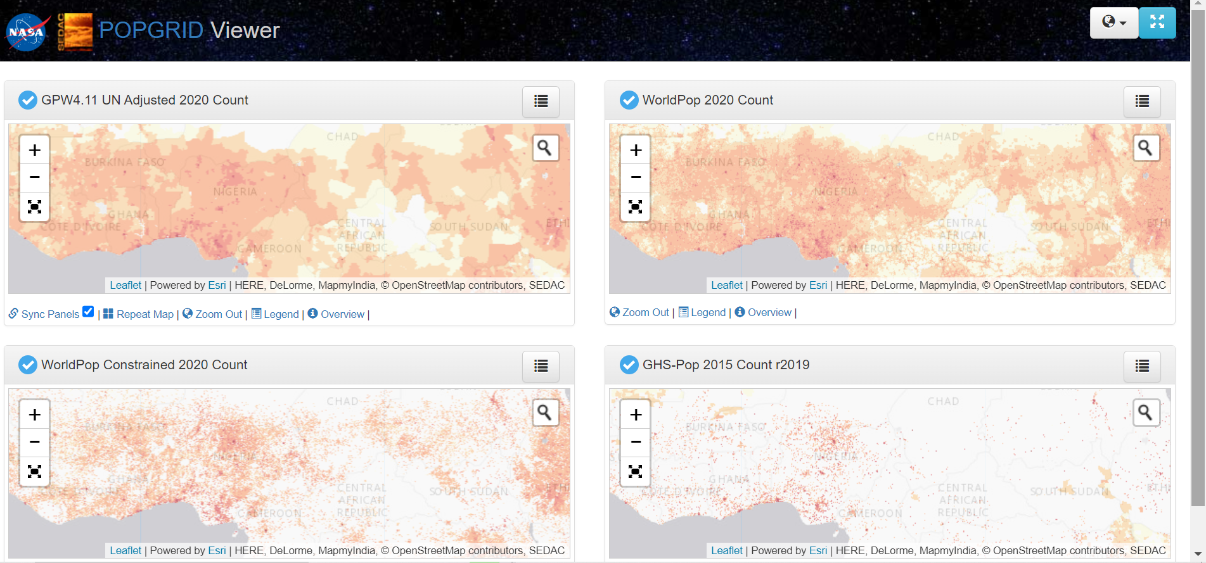

Slide 9
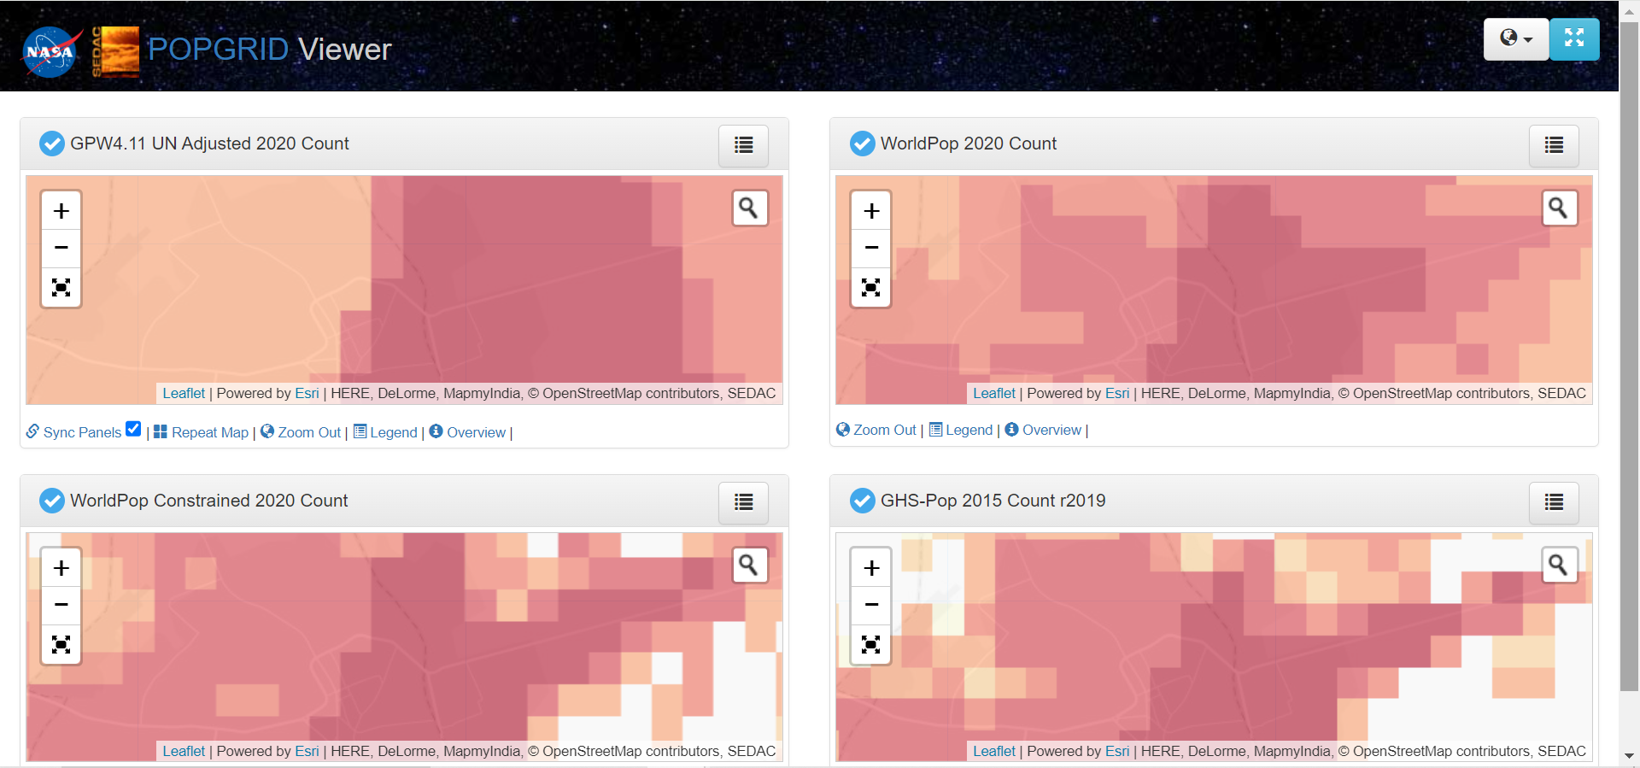
PopGrid view of the datasets for Maidiguri city in Nigeria

Slide 10
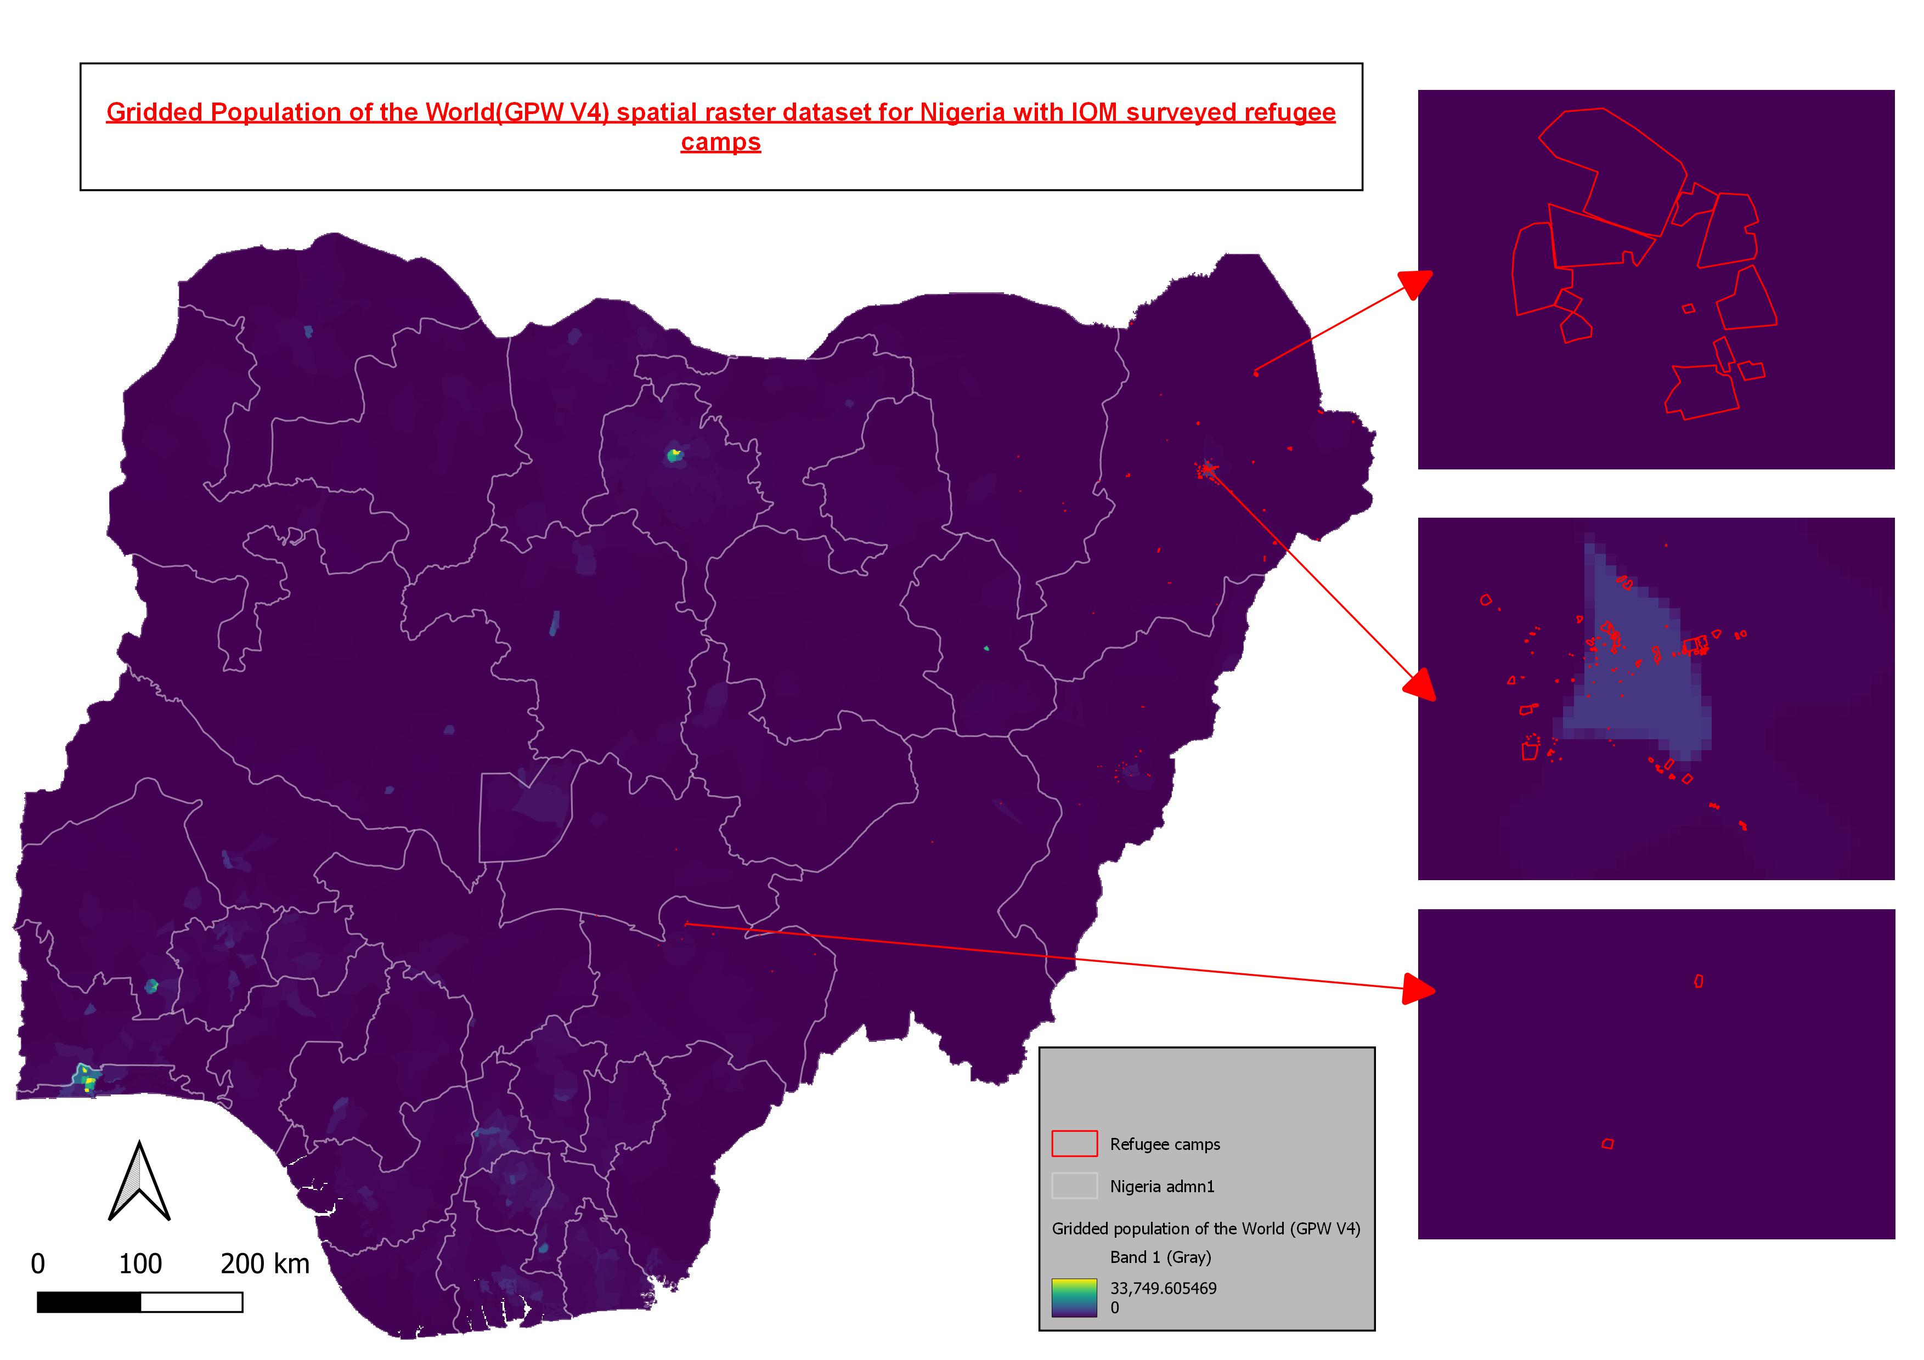
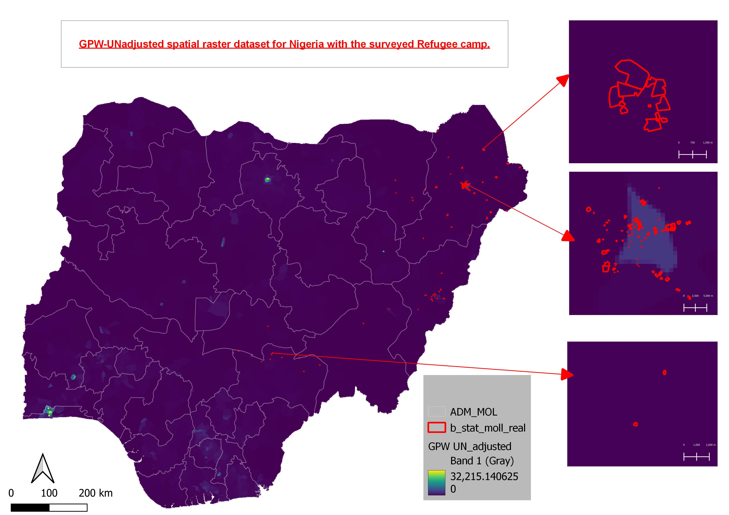
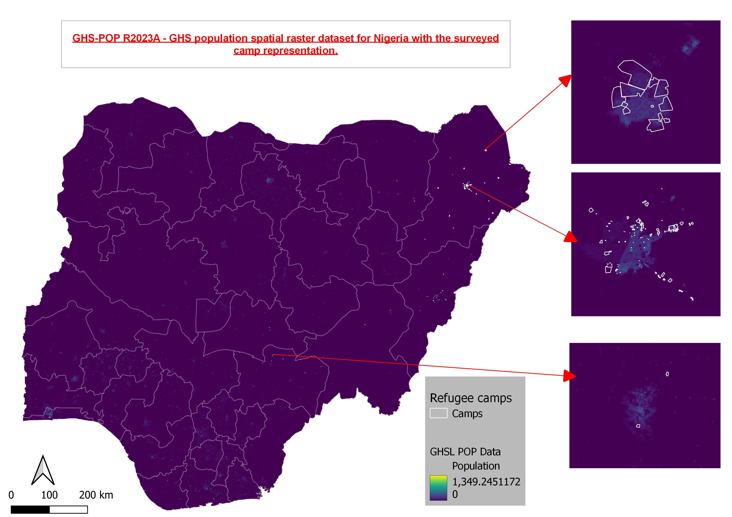

Slide 11
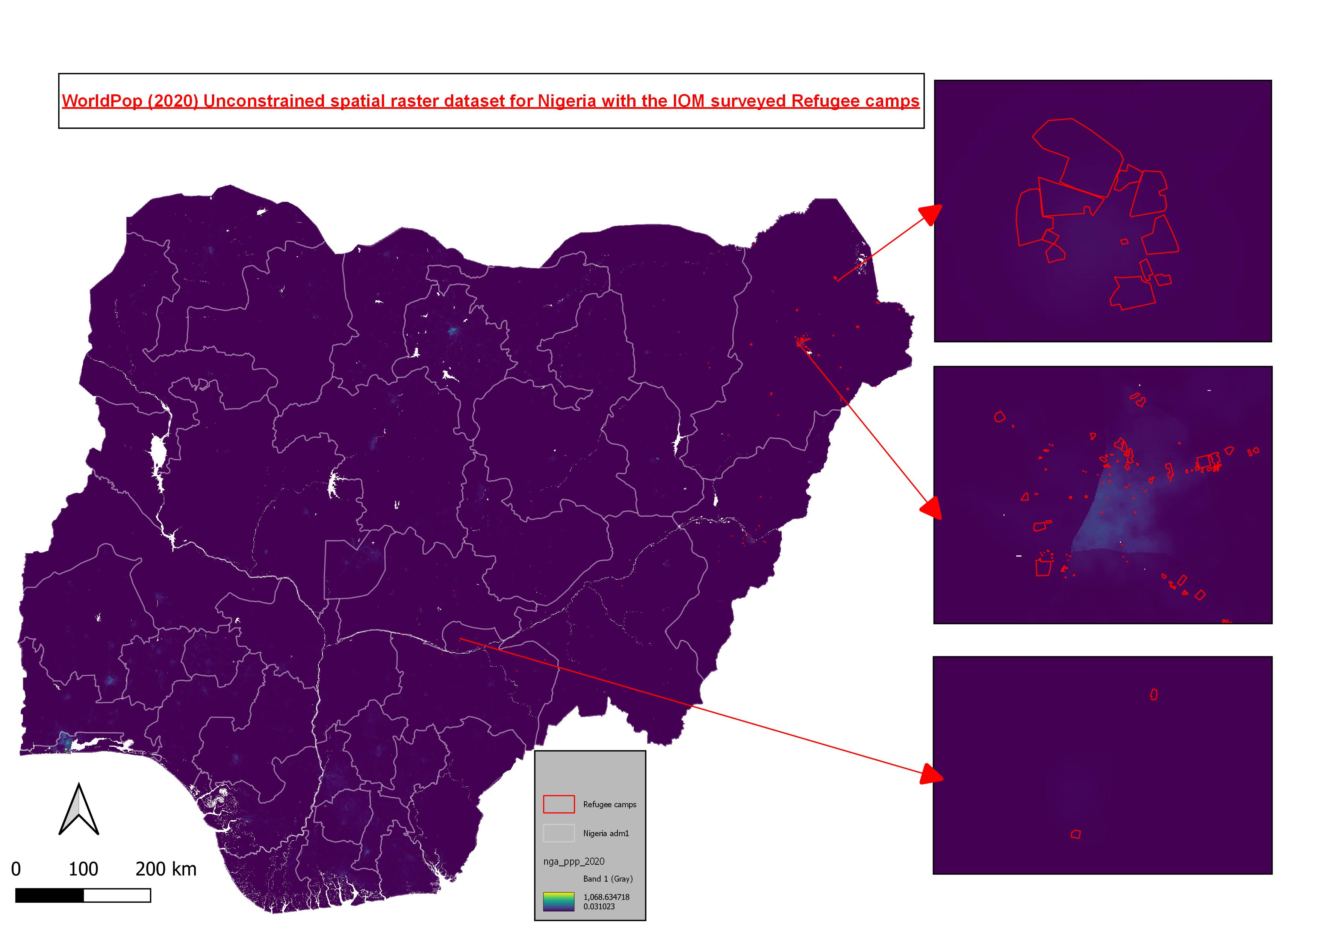
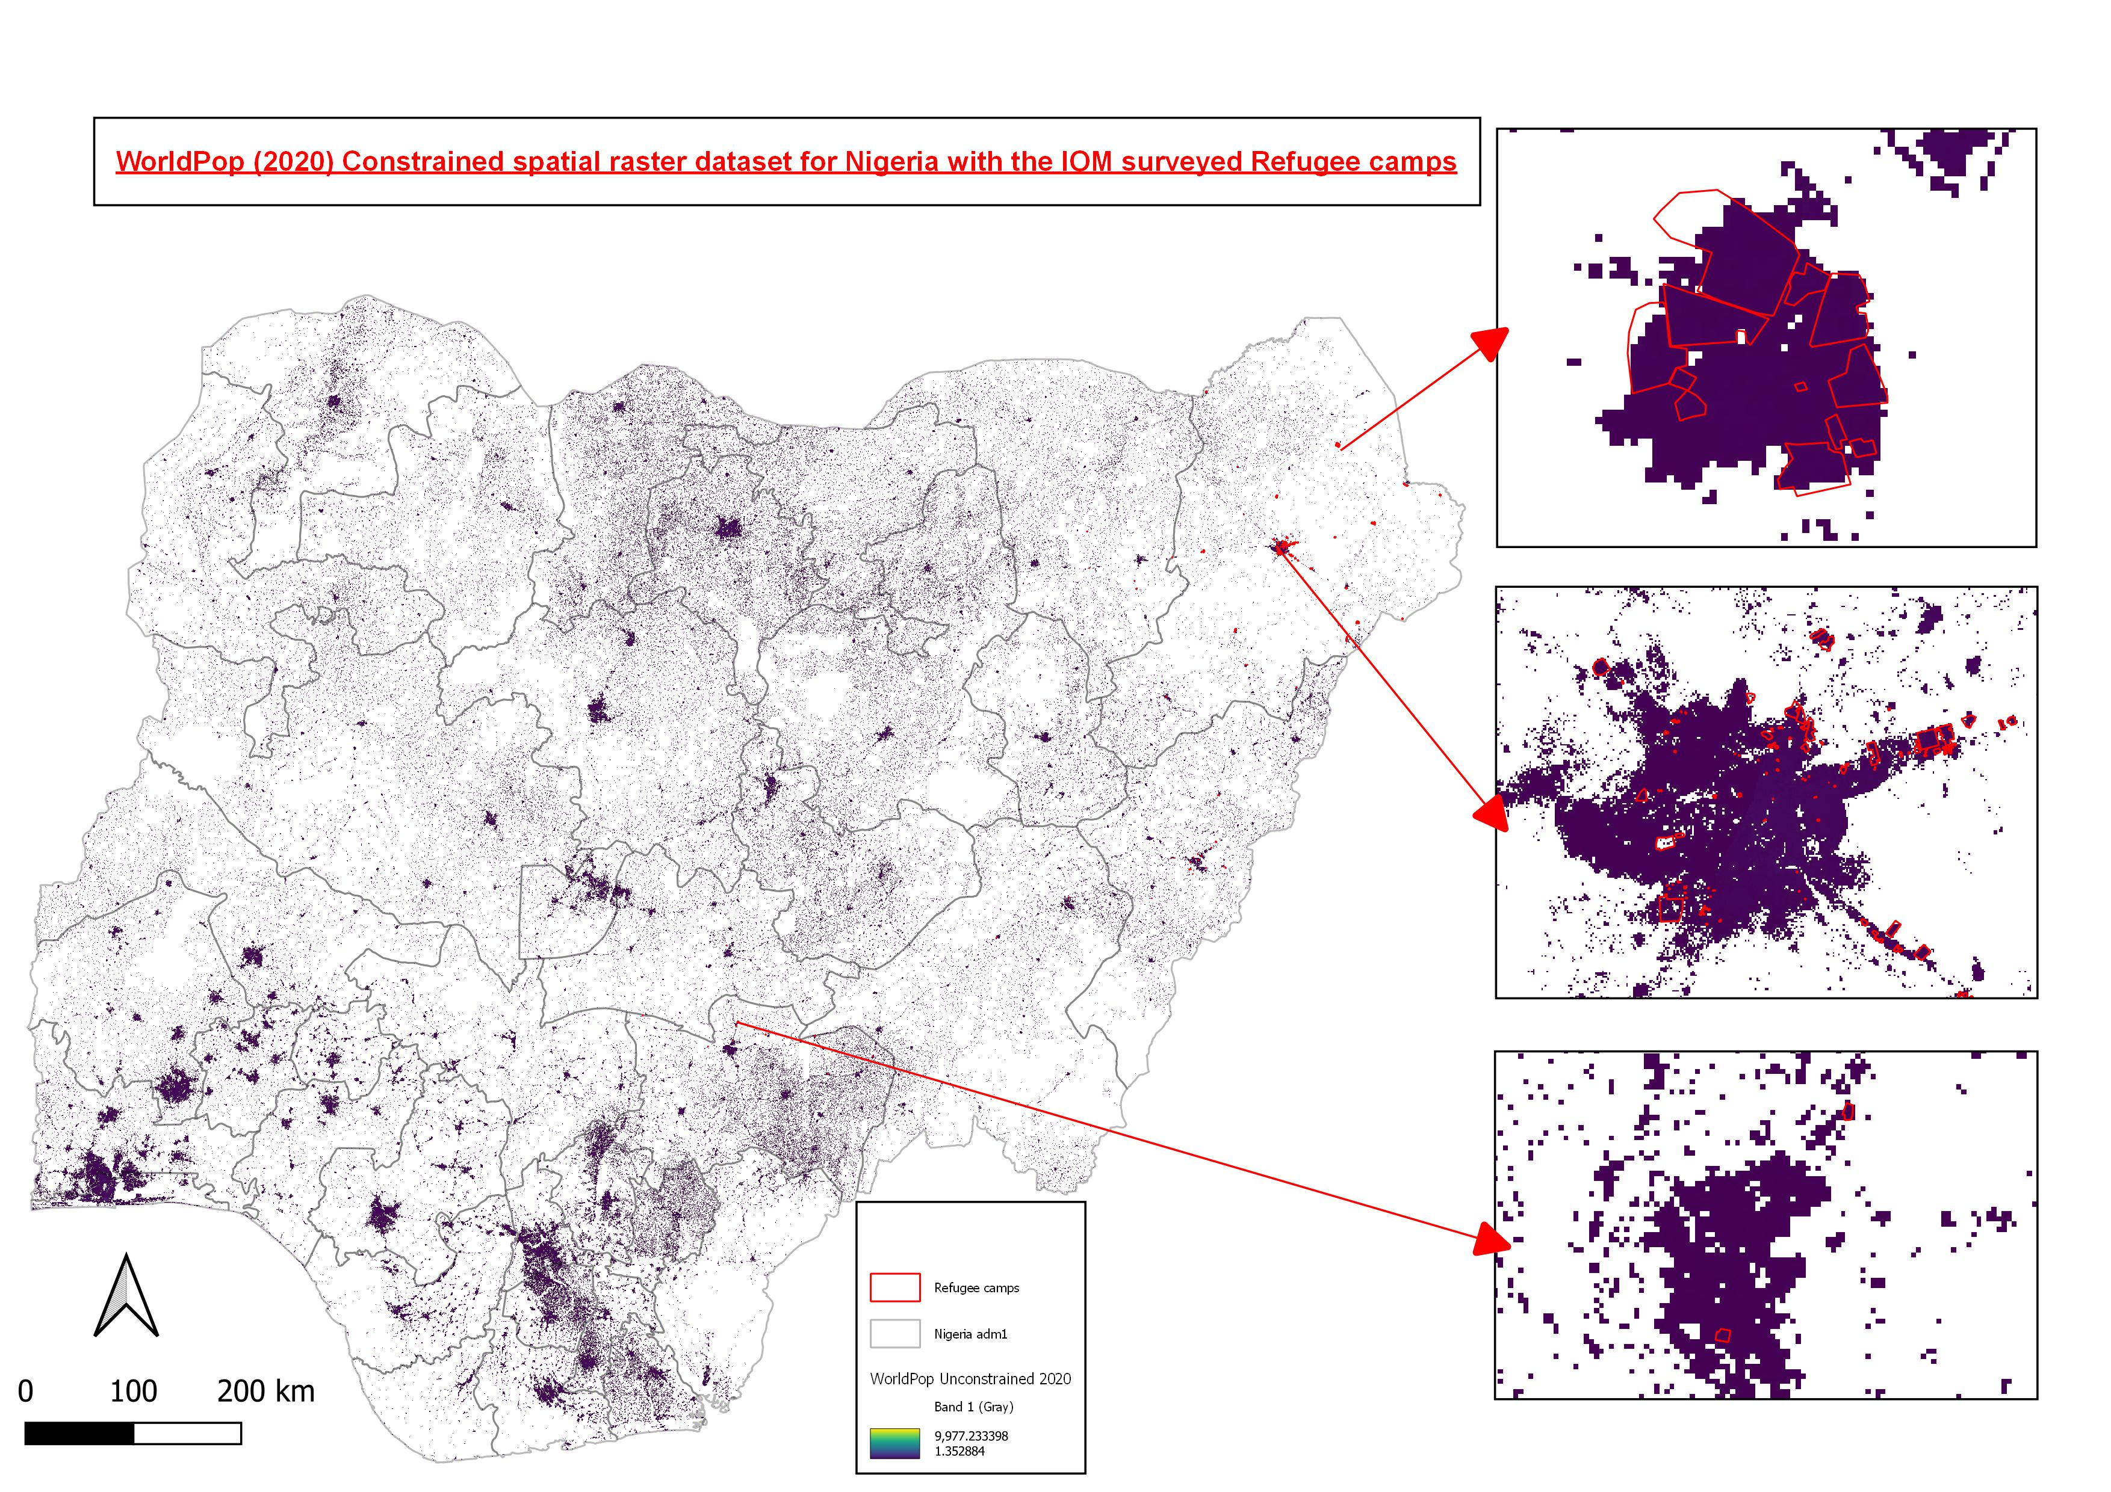

Slide 12
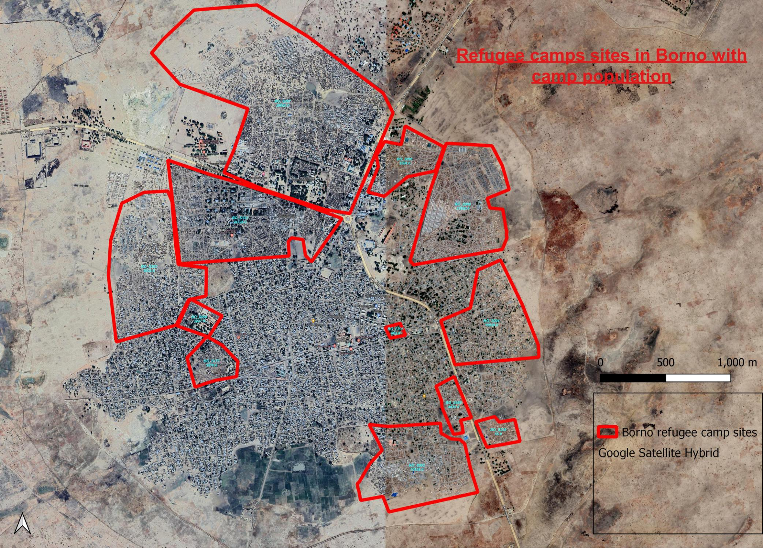

Slide 13
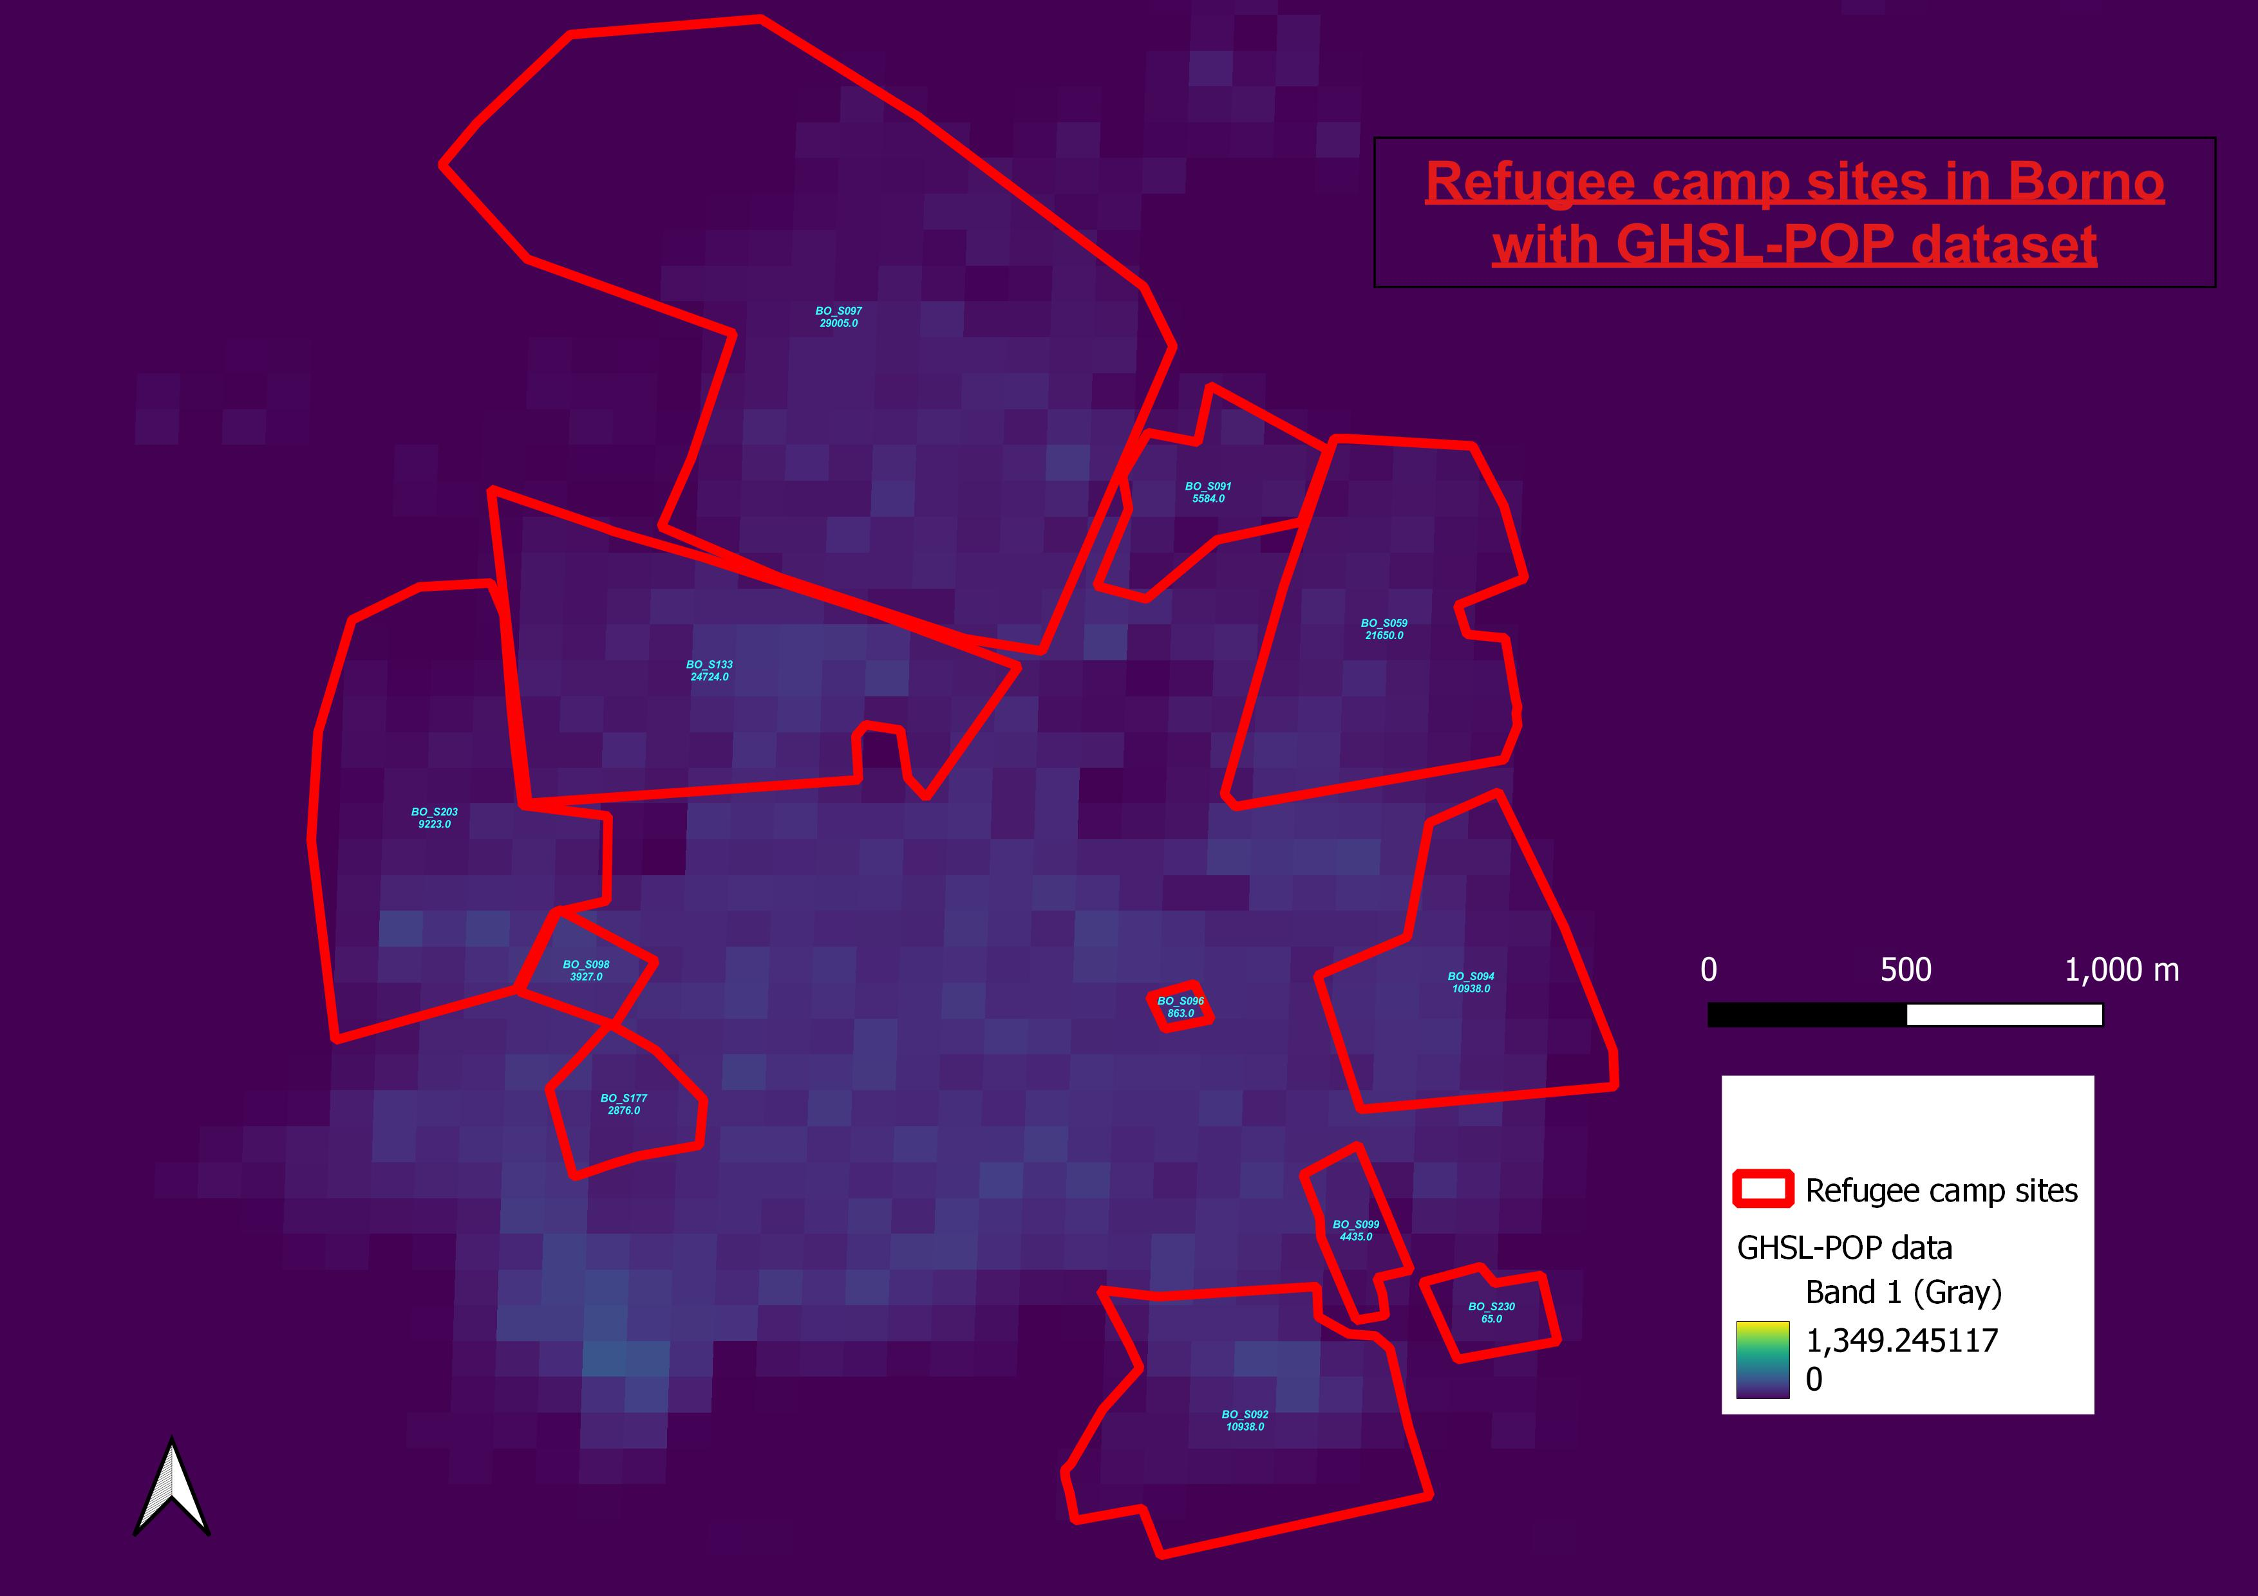
Notes:
This dataset combines information from population censuses with satellite-derived
built-up areas to allocate population counts from administrative units to a grid according to the
presence or absence of built-up area in the grid cell.
GEOSPATIAL CORRELATES:
Built-up areas mapped in the Global Human
Settlement Layer Built Up Extent (GHS-BUILT)
SOURCE OF DATA ADJUSTMENT:
UNPD estimates.
METHOD:
Binary dasymetric mapping.

Slide 14
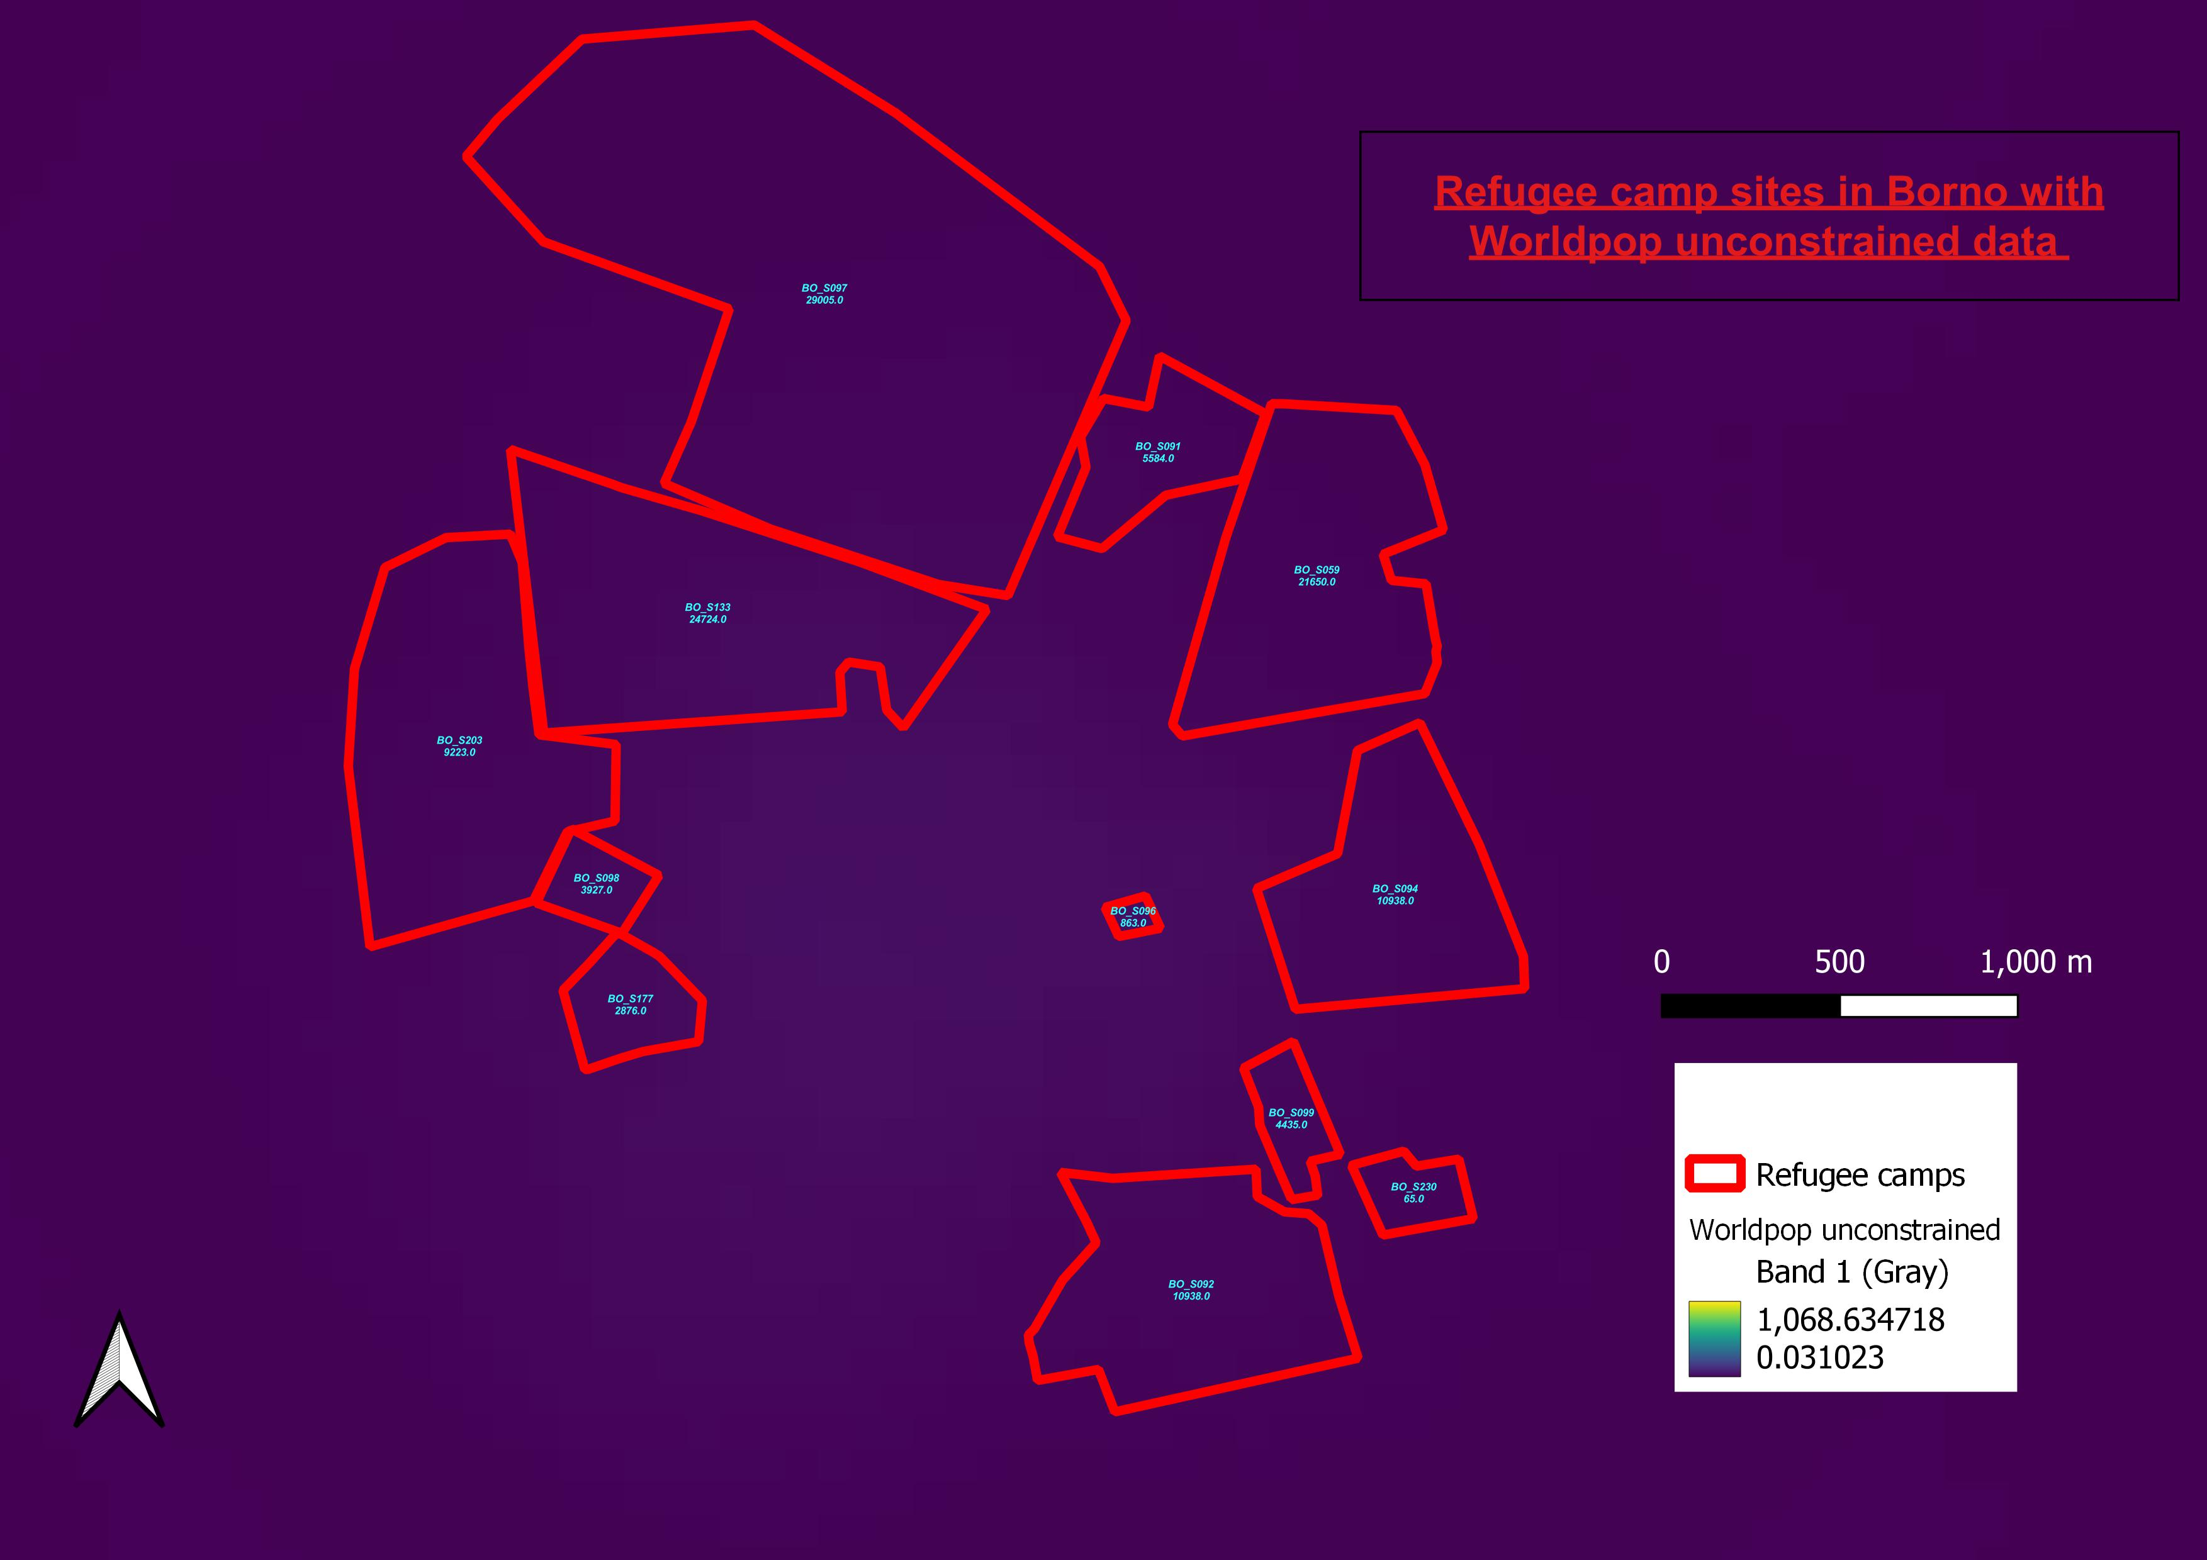
Notes:
GEOSPATIAL CORRELATES:
Roads, land cover, built structures, cities or urban
areas, nighttime lights, infrastructure, environmental,
protected areas, and water bodies.
SATELLITE IMAGERY:
Landsat Enhanced Thematic Mapper (ETM), Landsat,
TerraSAR-X, TanDEM-X, DMSP and Visible Infrared
Imaging Radiometer Suite (VIIRS).
SOURCE OF DATA ADJUSTMENT:
Country-official estimates and UNPD estimations
METHOD:
Random forest; however, the same method is not
always used across all countries and time.

Slide 15
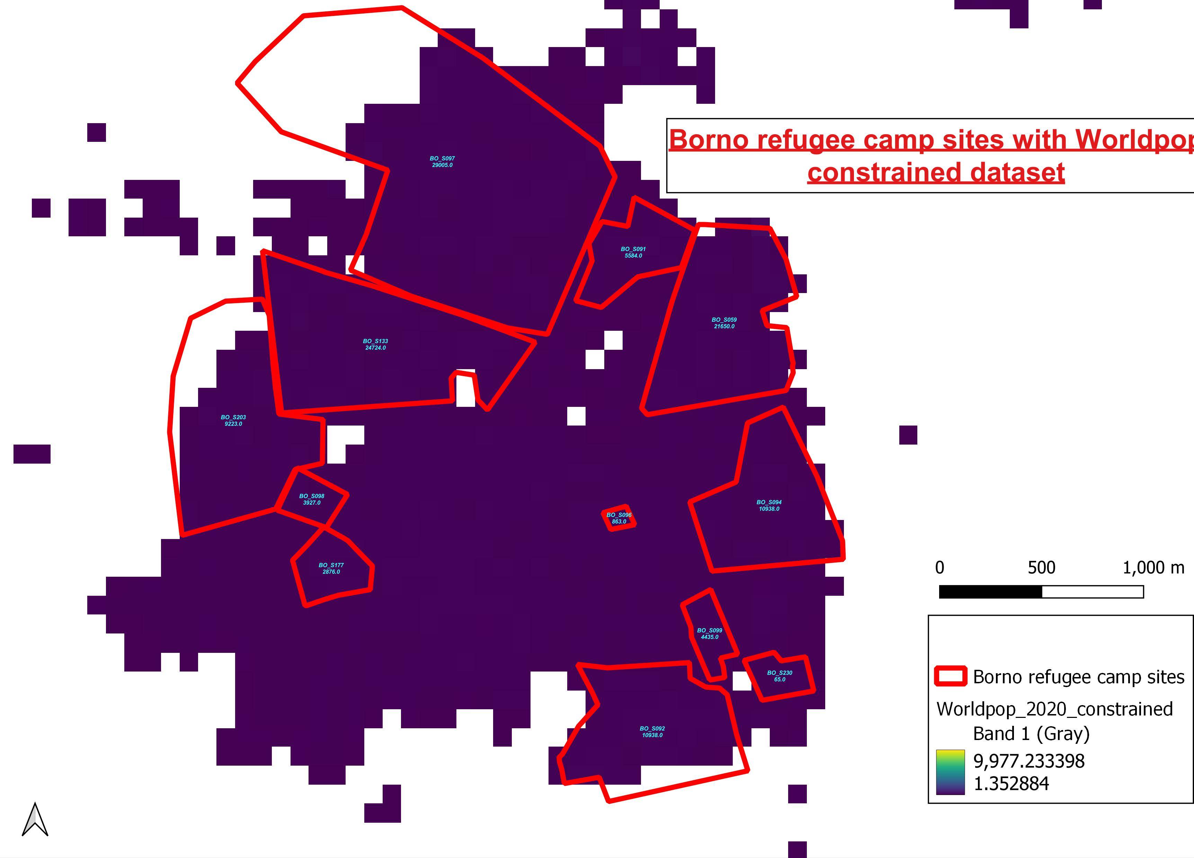

Slide 16
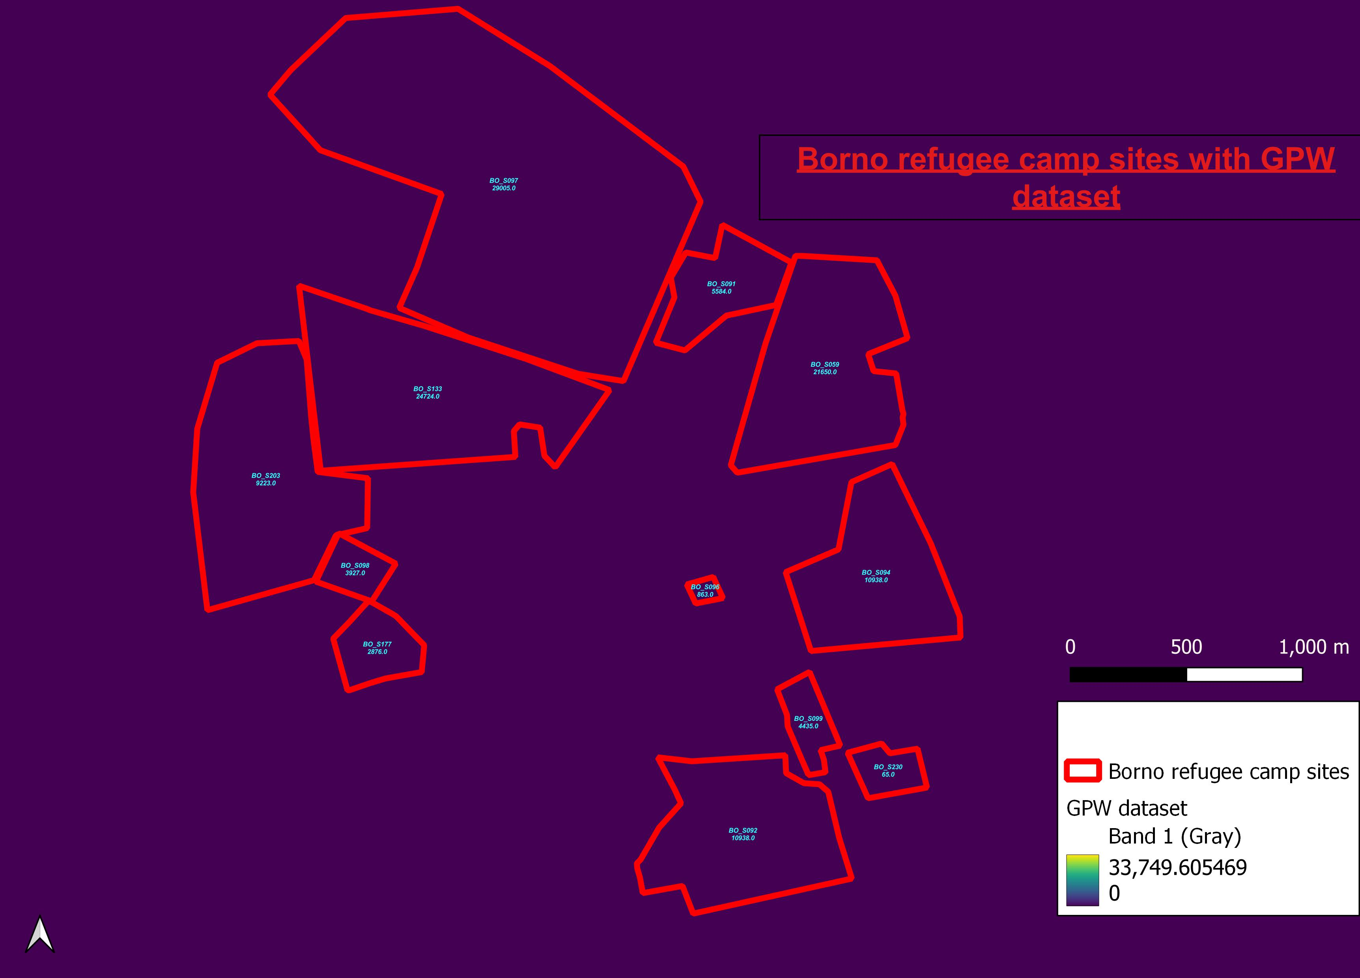

Slide 17
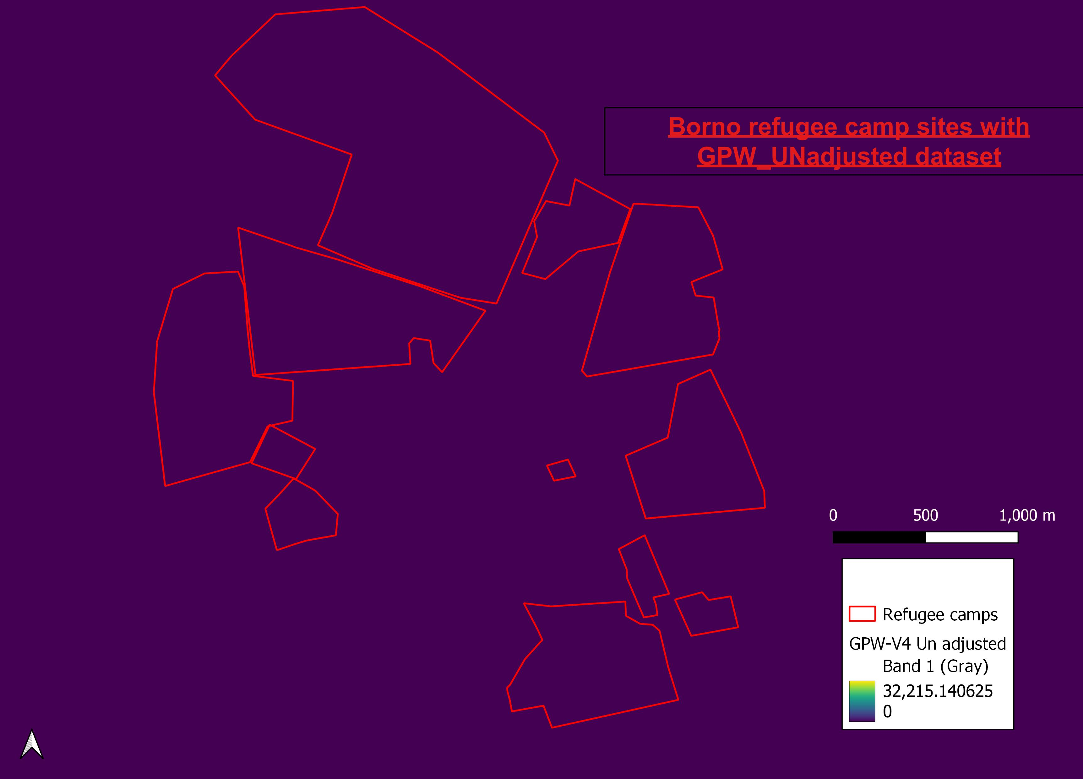

Slide 18
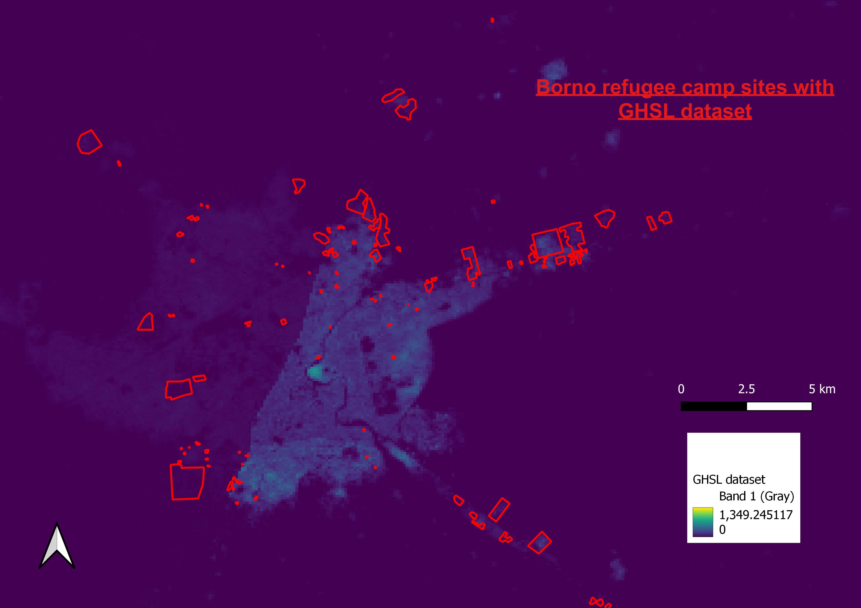

Slide 19
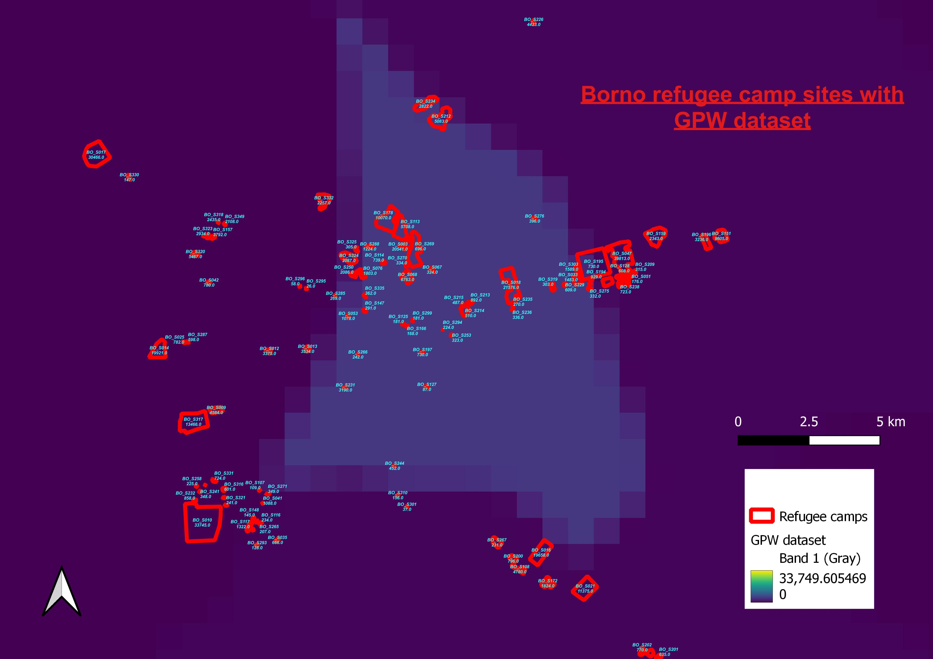
Notes:
. GPW is
a minimally modeled dataset that remains true to the census
and is, therefore, a suitable choice for large-scale analysis
across regions, and for analyses that require an independent
measure of population that is not affected by covariates
used in most other modeling approaches. However, as a
result of its minimally modeled approach, it tends to show
much higher population counts in, for example, rural areas of
countries that only report census data for larger geographic
units
, GPWv4 has global population grids that are based on the original country
census population totals and grids adjusted to the UN World Population Prospects country-bycountry estimates, so that the sum of all grid cells totals to the UN estimates.

Slide 20
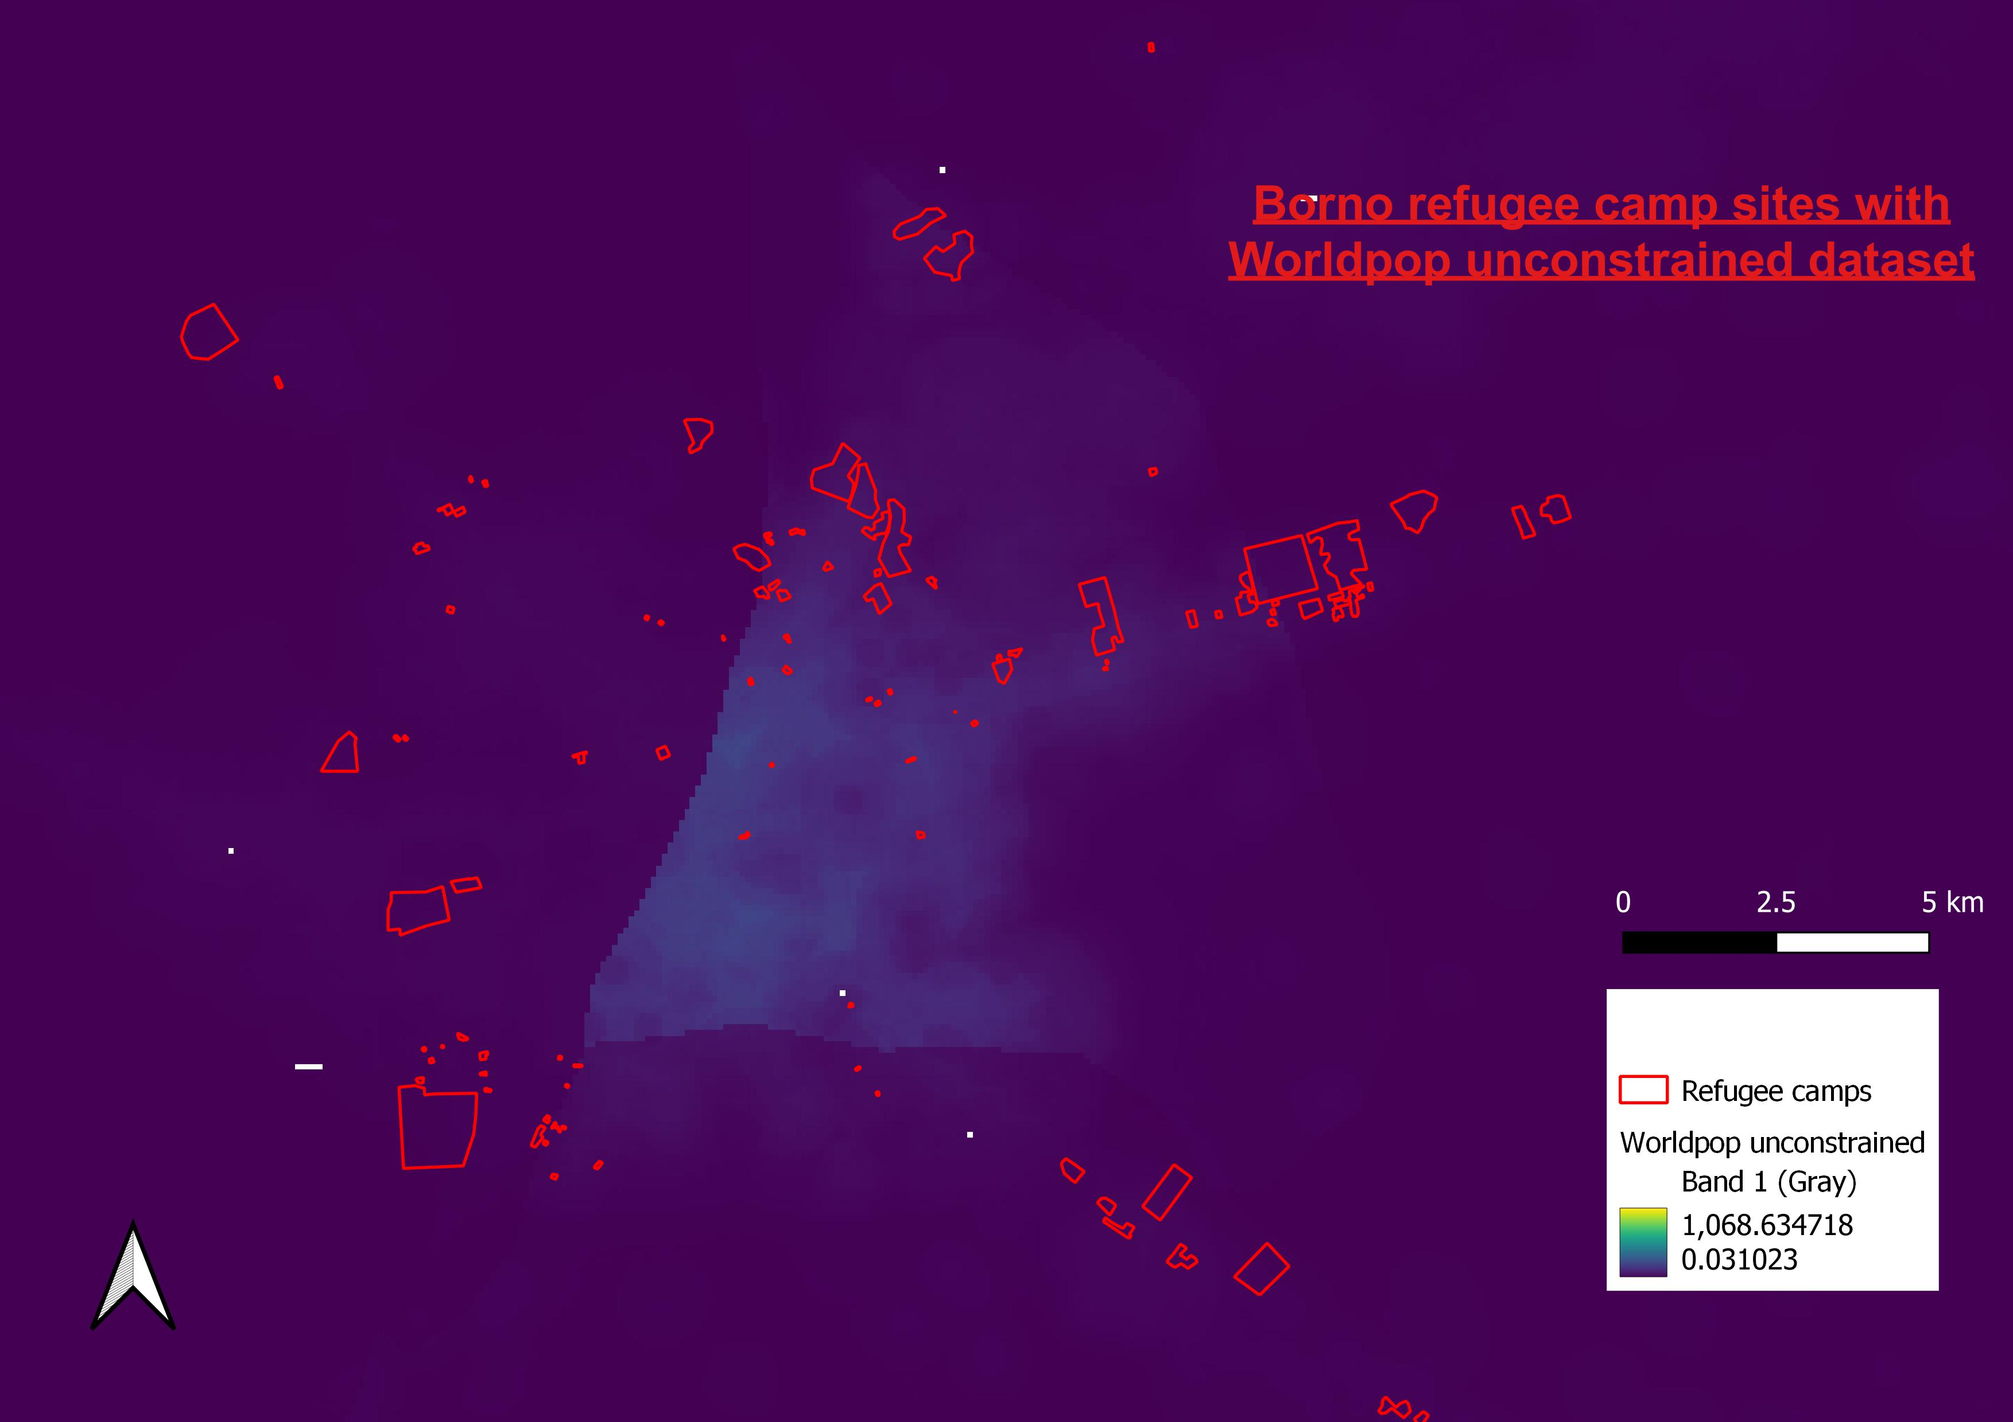

Slide 21
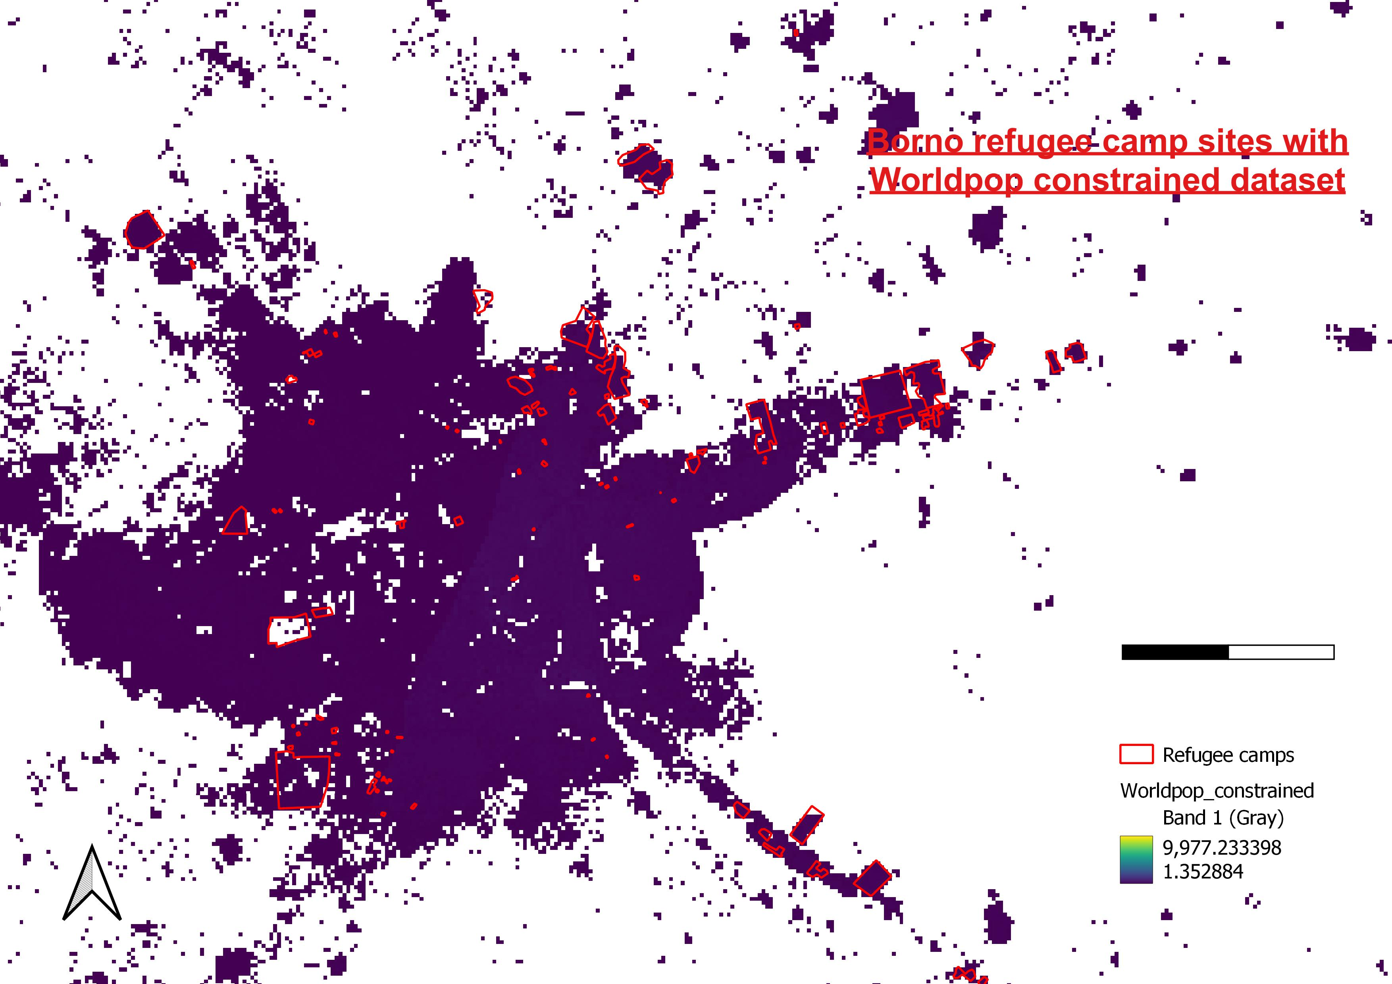

Slide 22
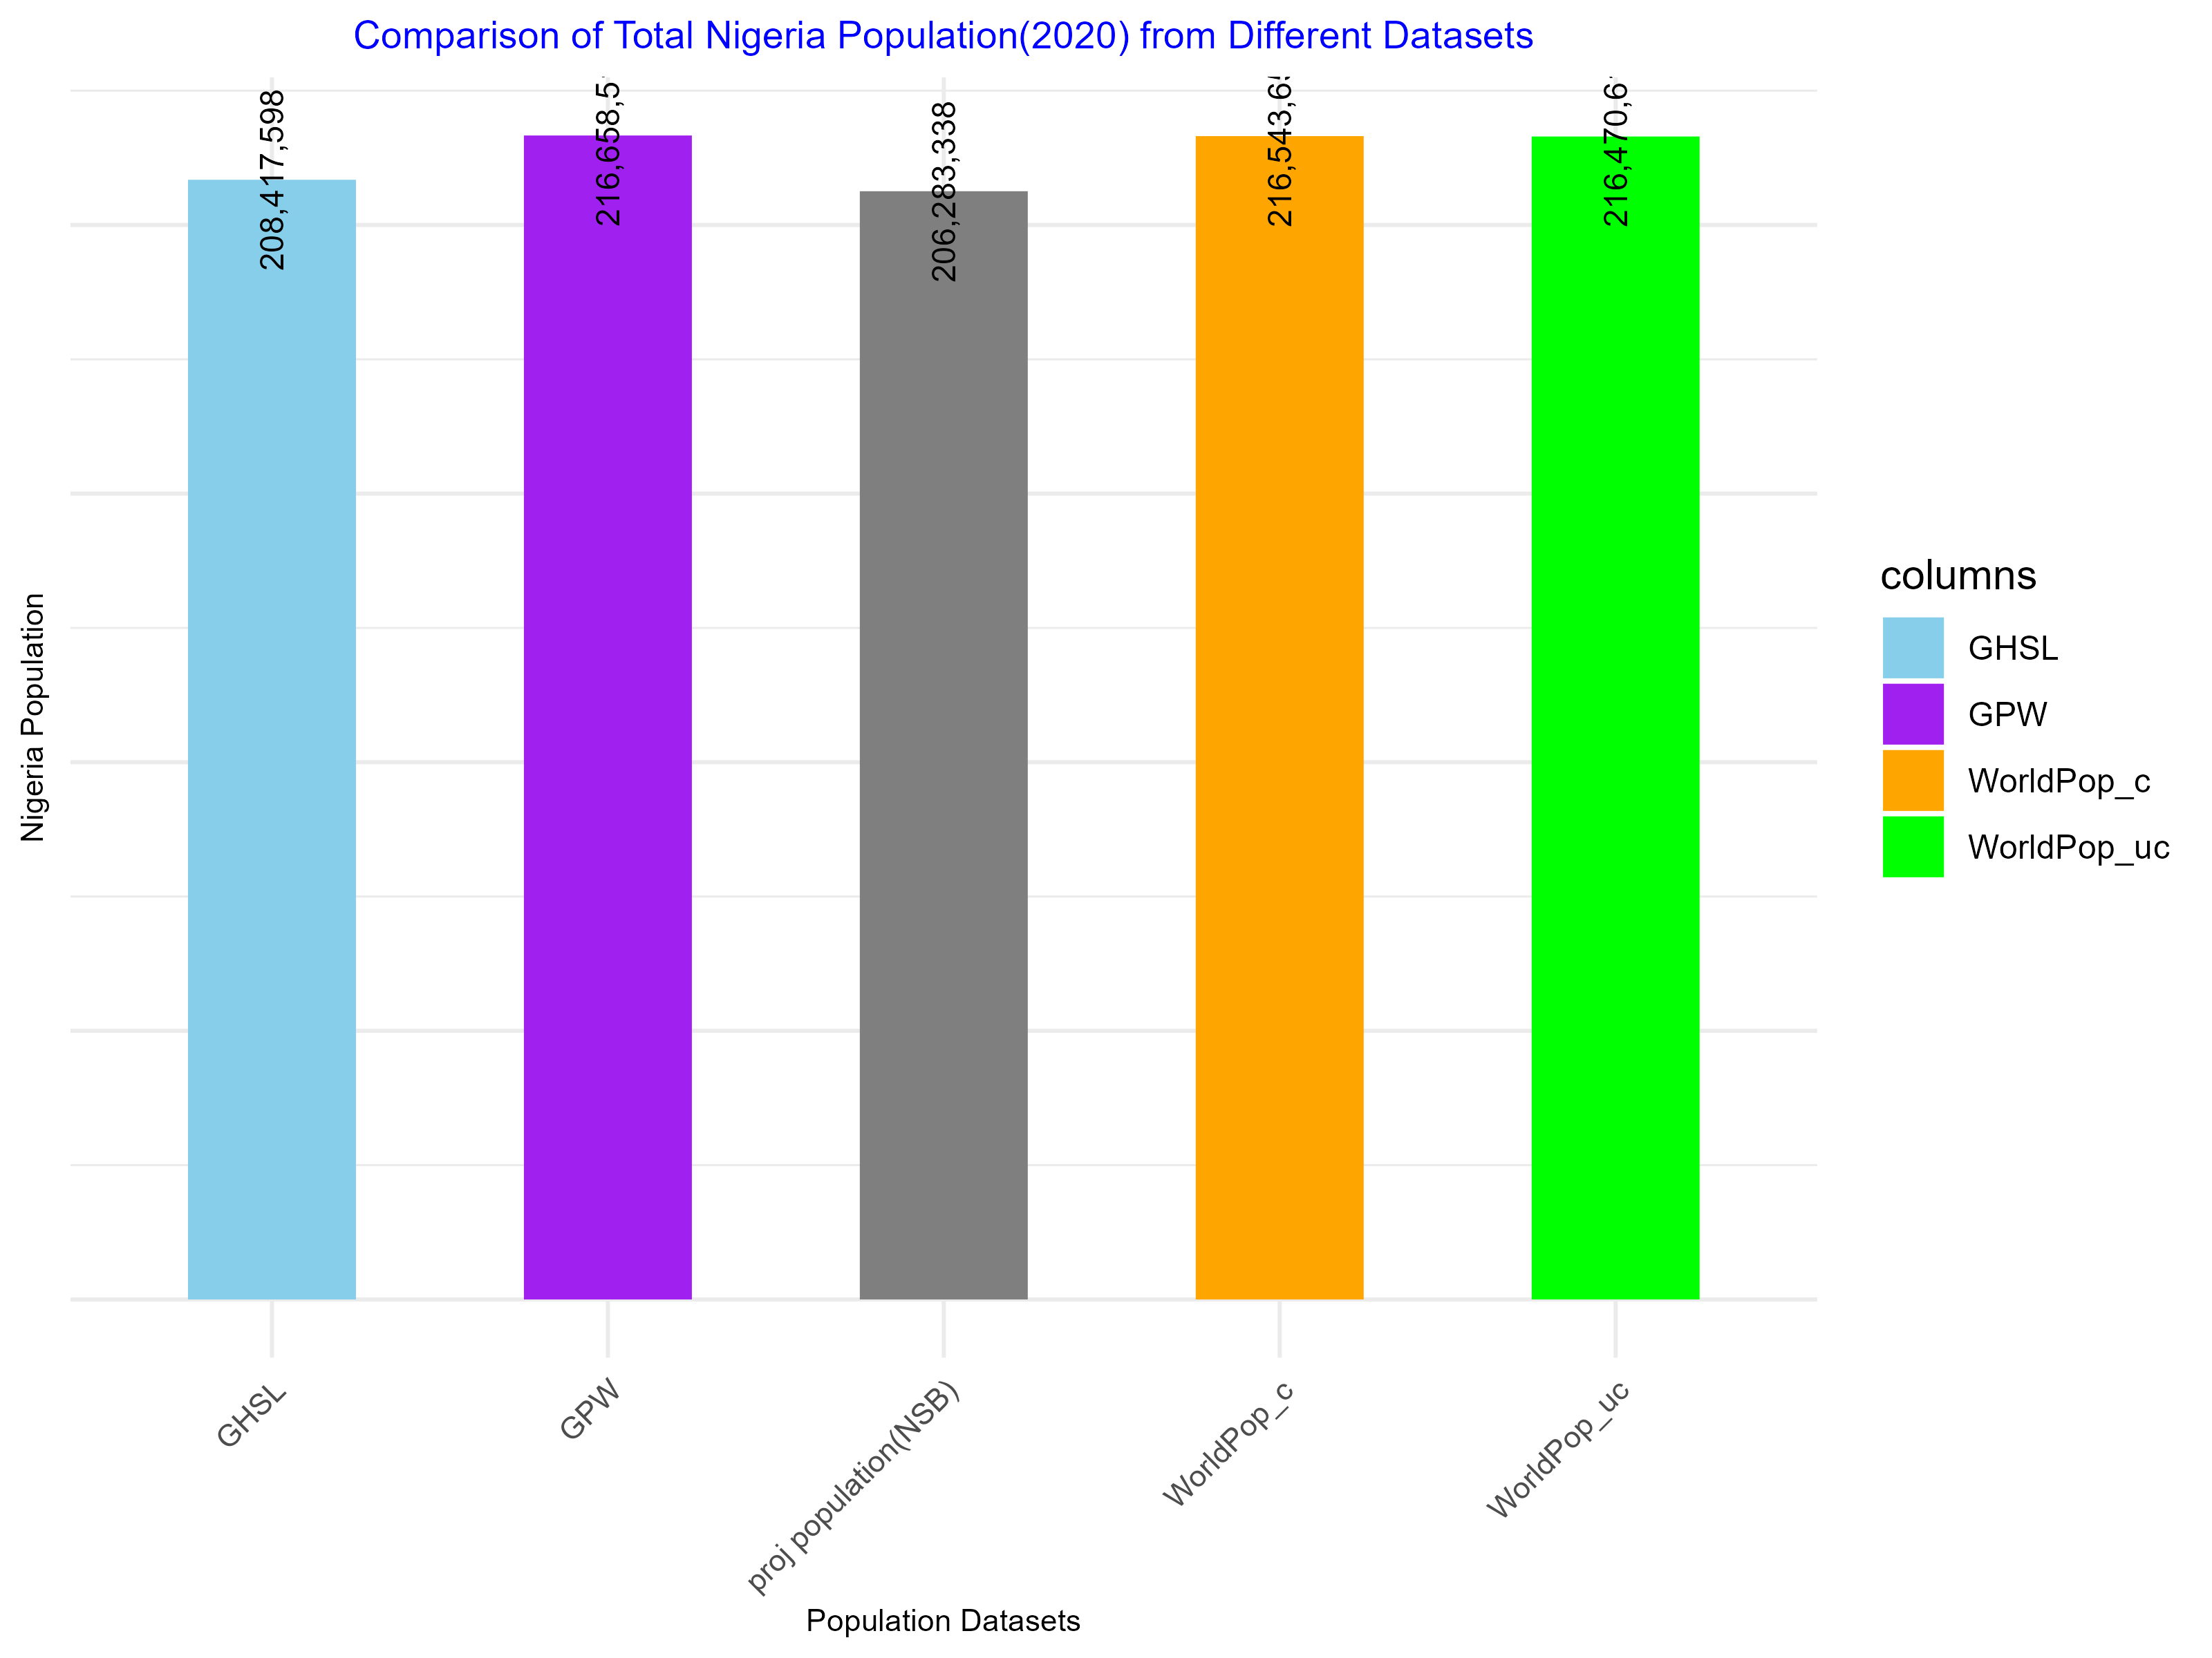


Notes:
GPWv4 is one of two datasets that provide estimates of basic demographic characteristics (age and sex7
) in addition tov opulation counts and density (the other is WorldPop).
national statistic beaur nigeria official had produced this projected population census for the year 2020(206,283,338)

Slide 23
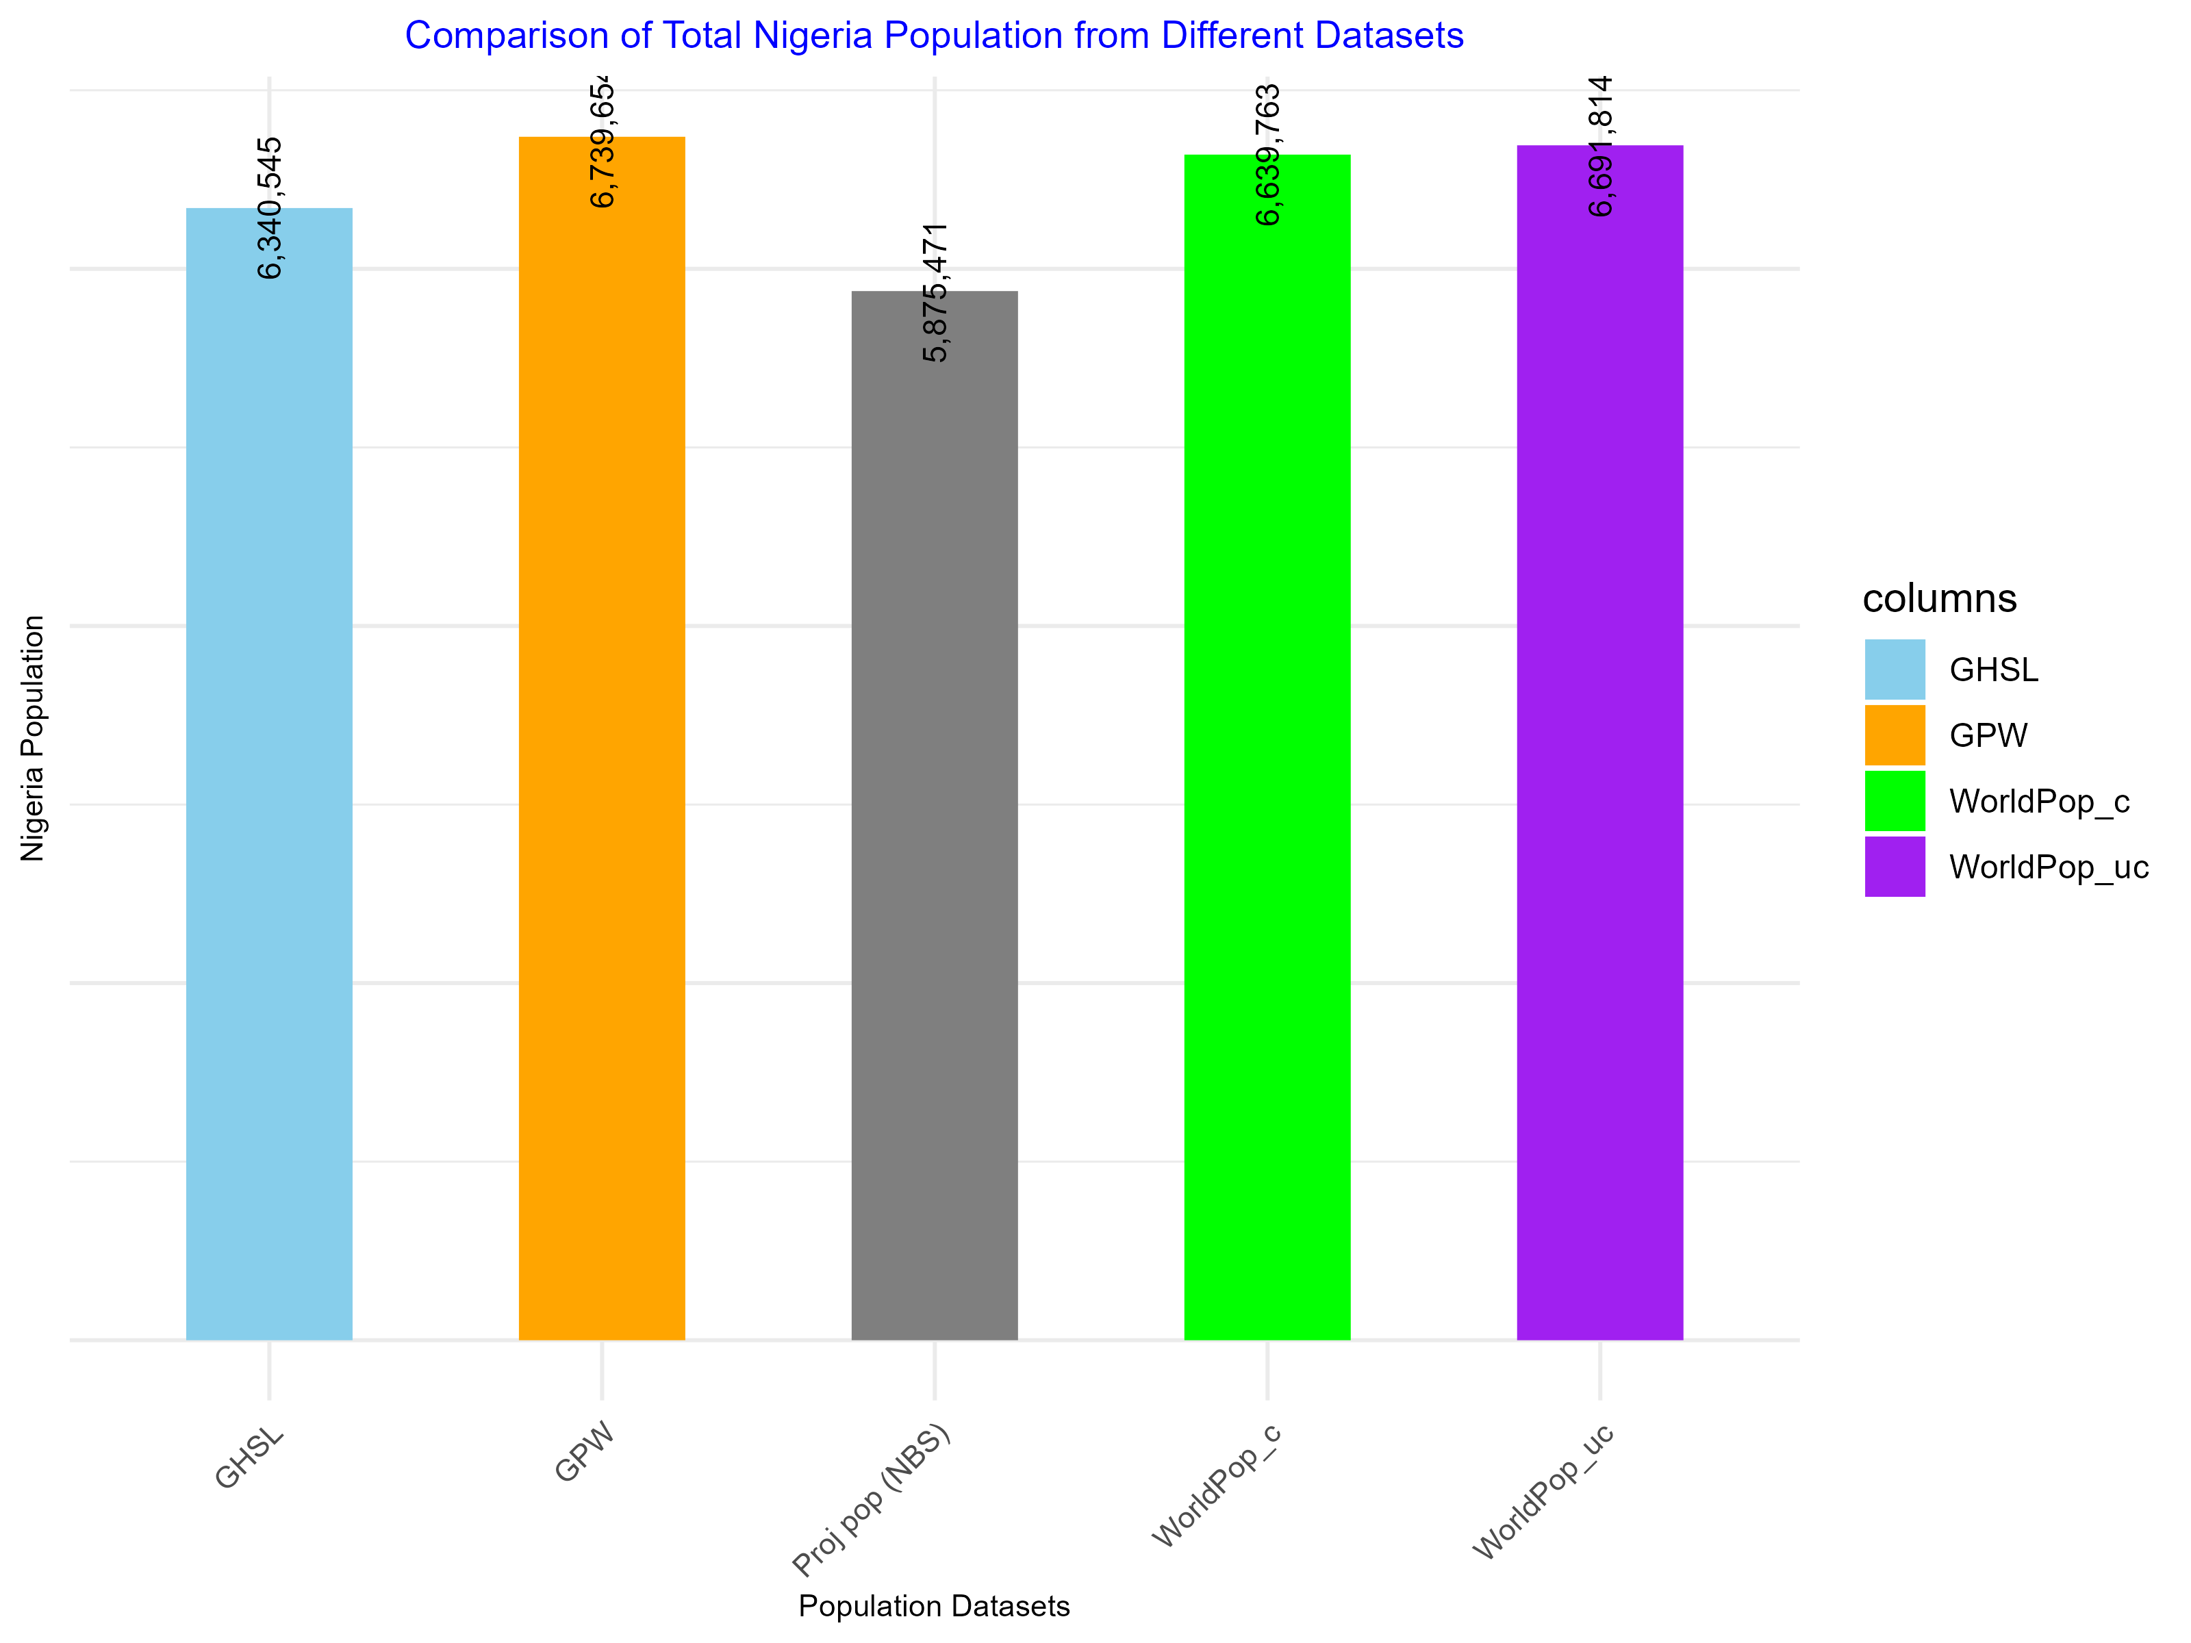
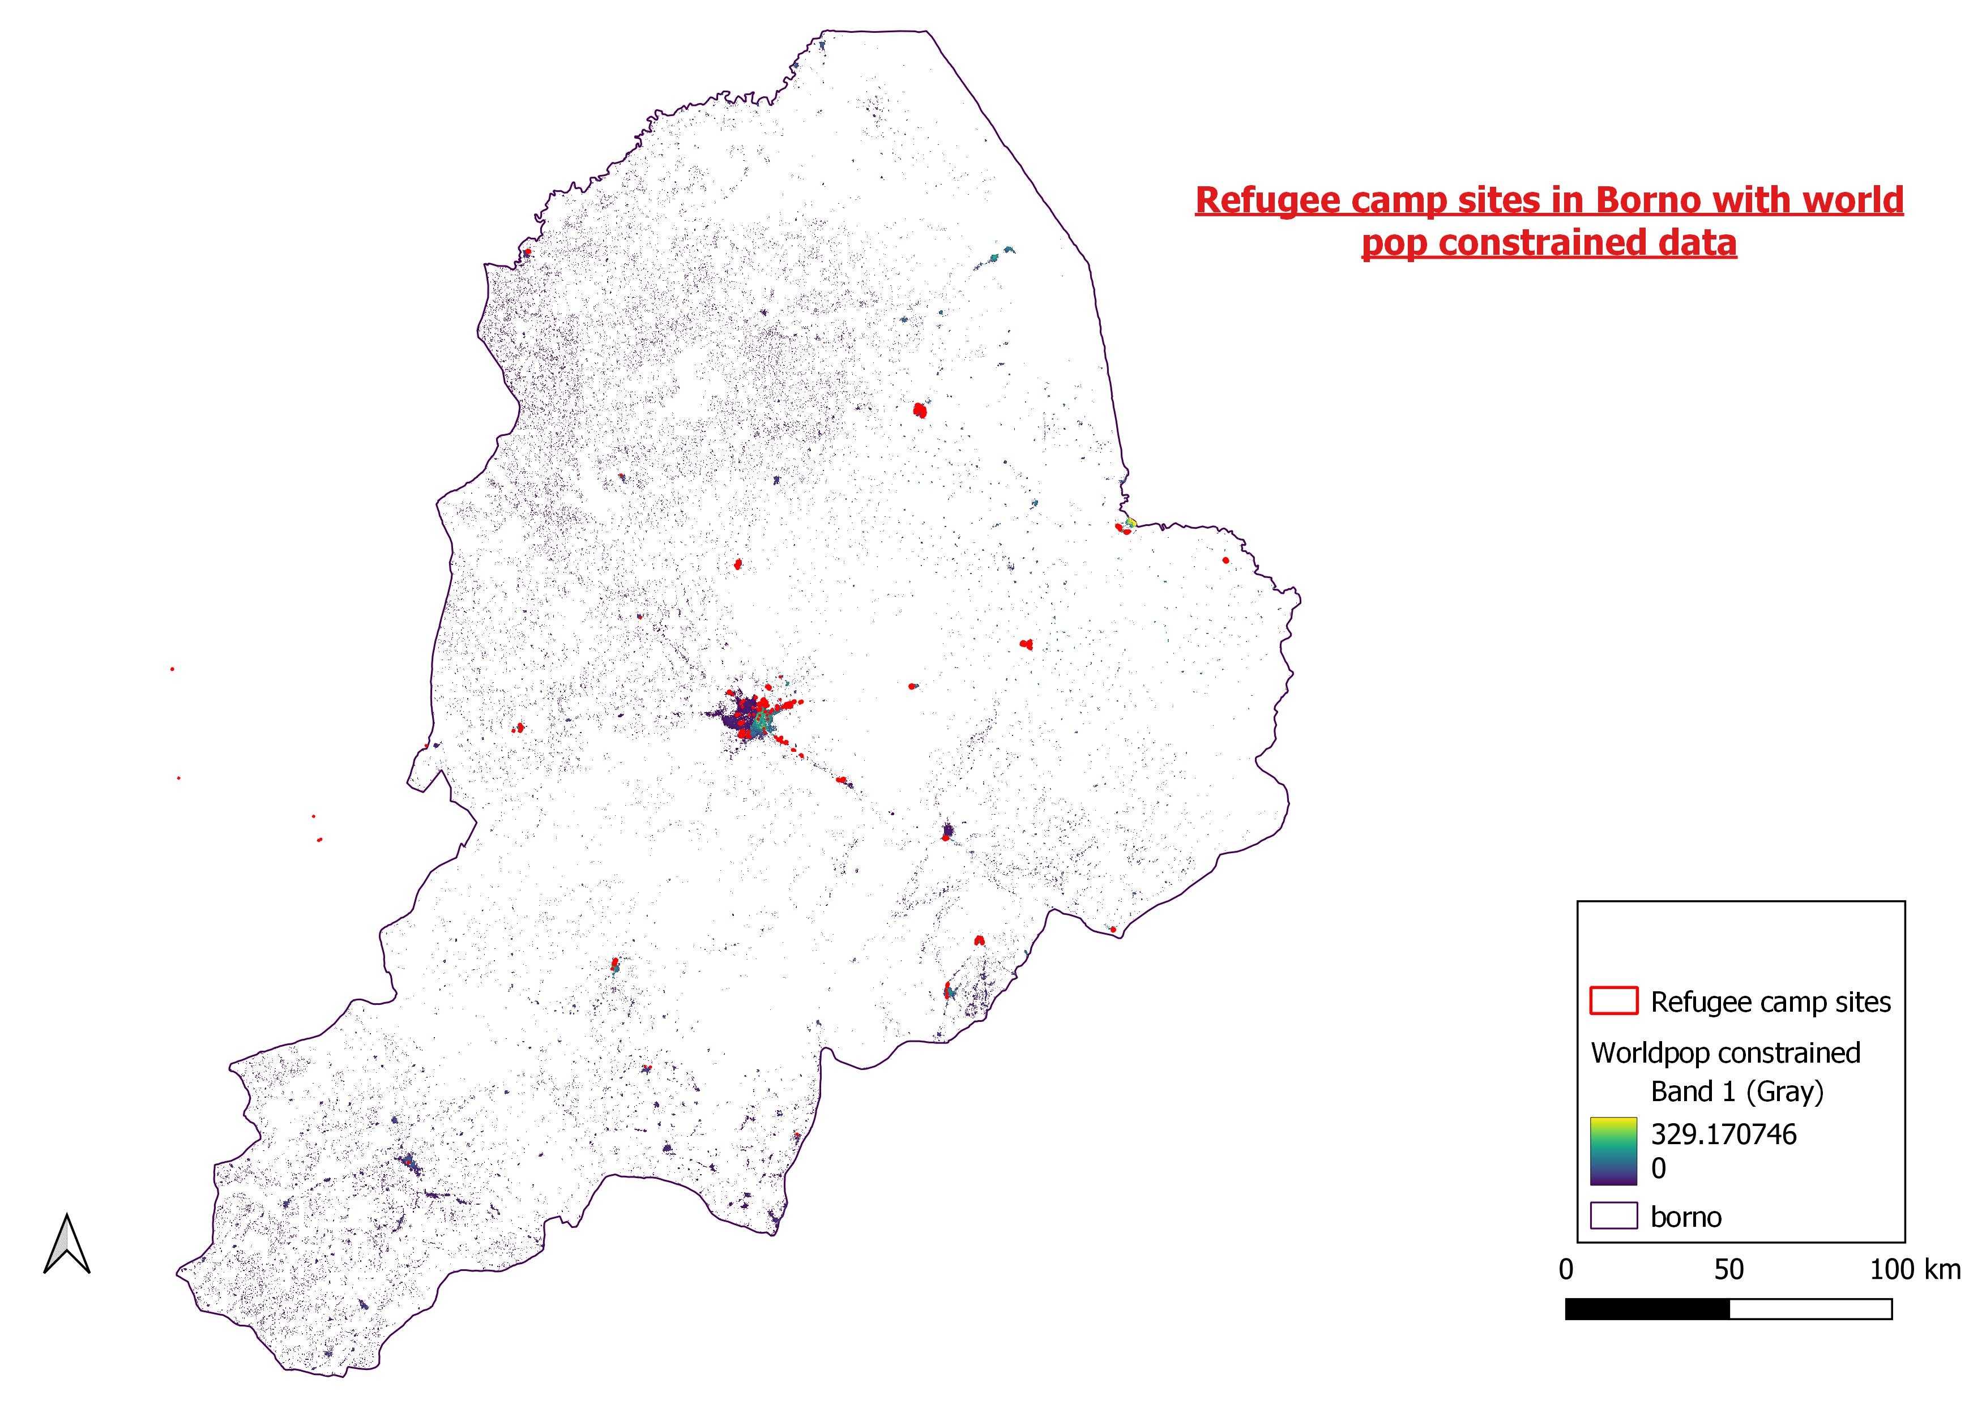

Slide 24
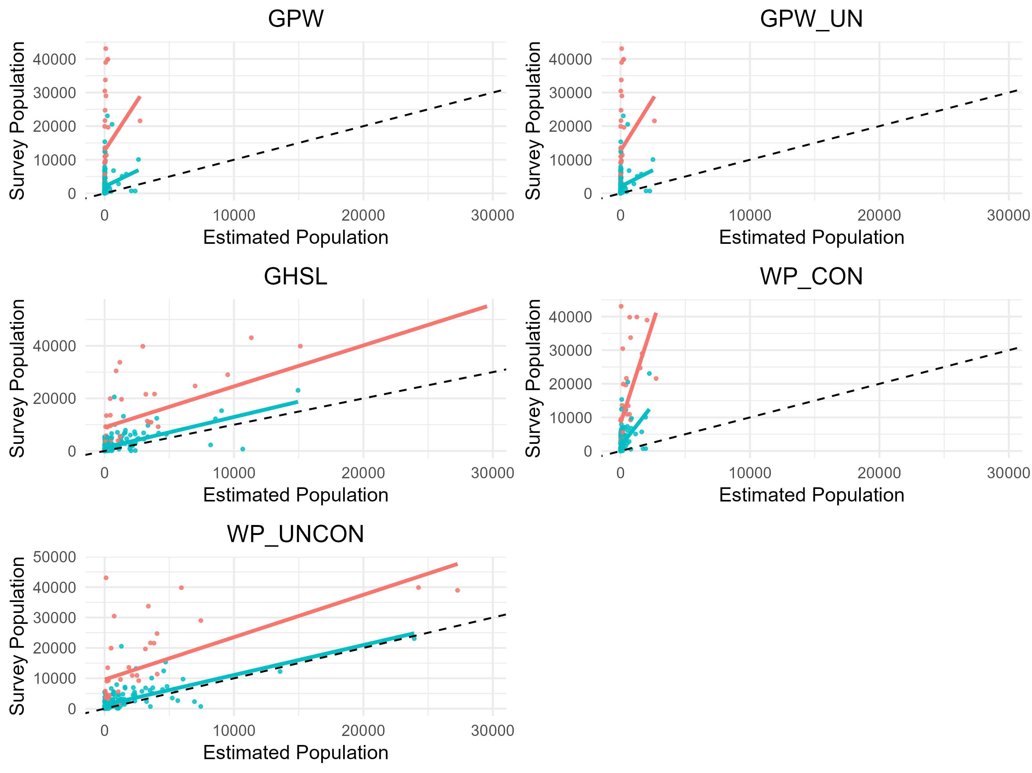
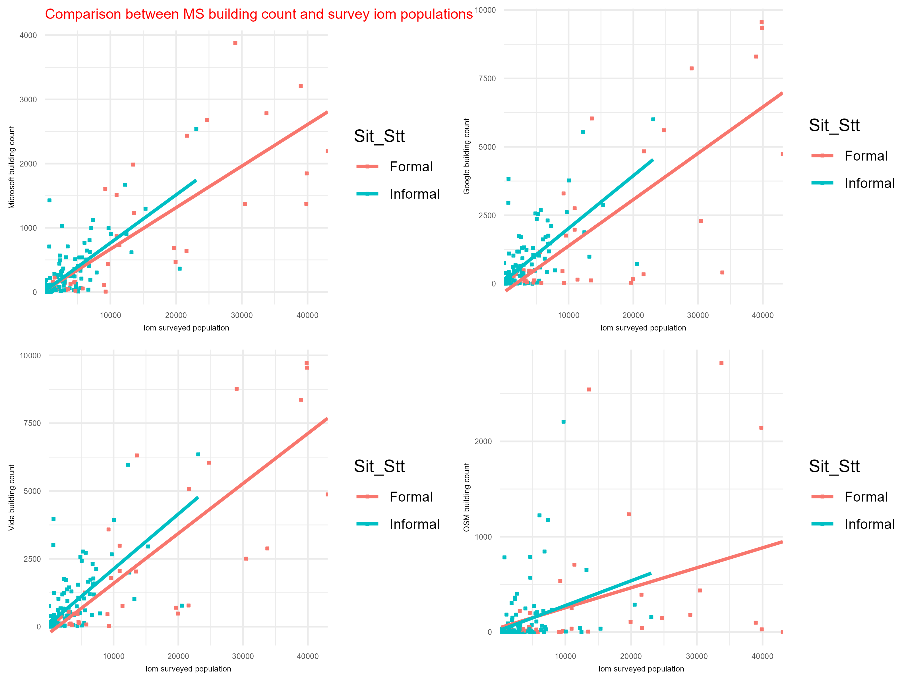

Slide 25
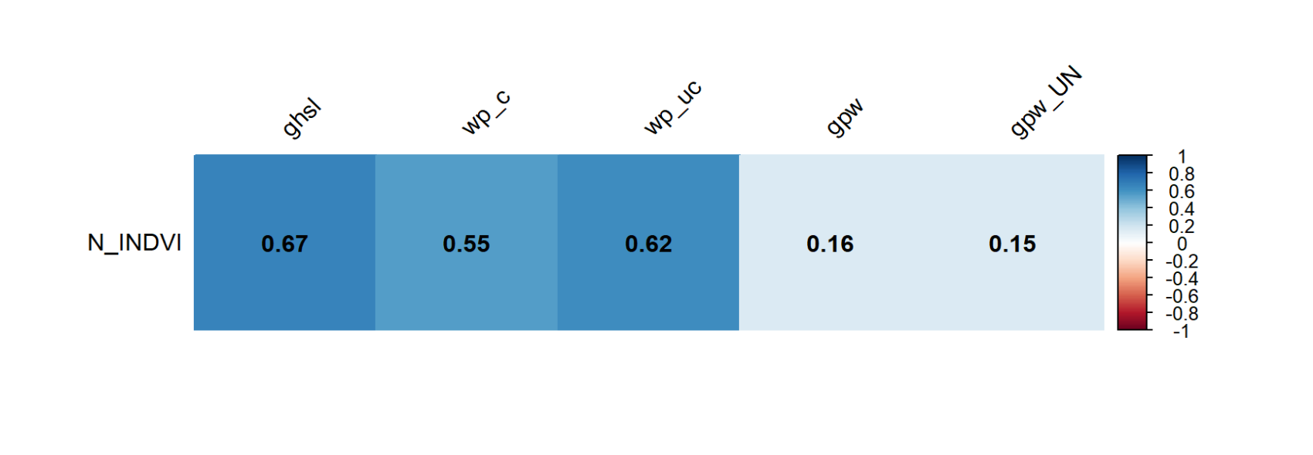

Slide 26
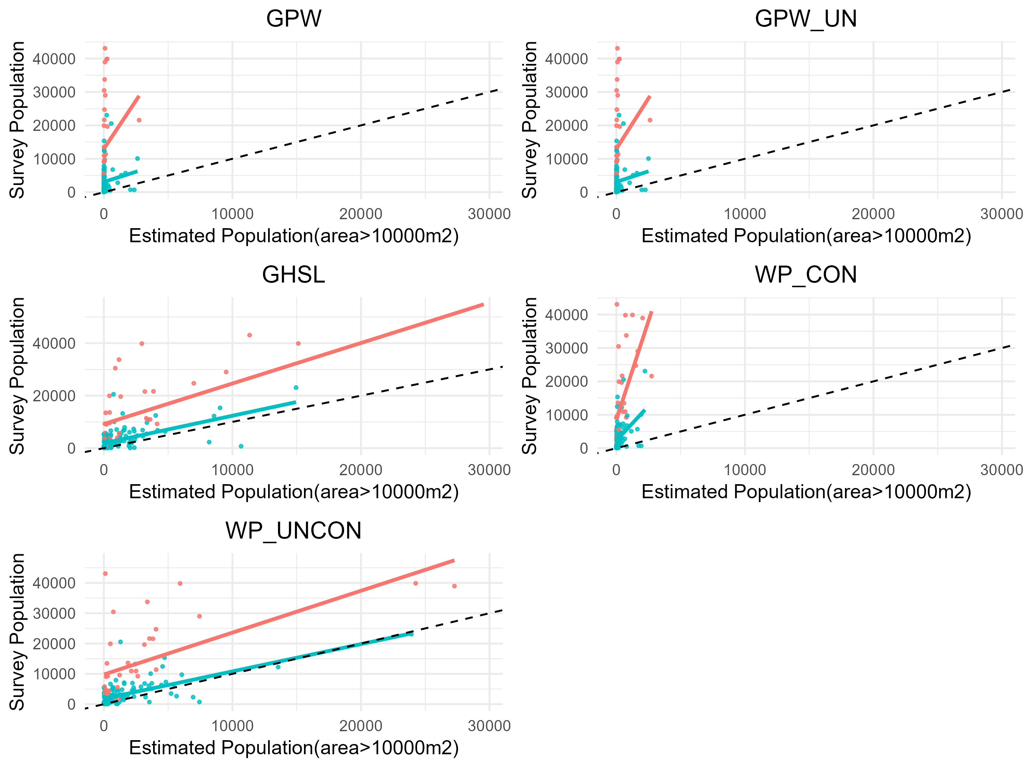
Number of Camps with area>10000m2: 154

Slide 27
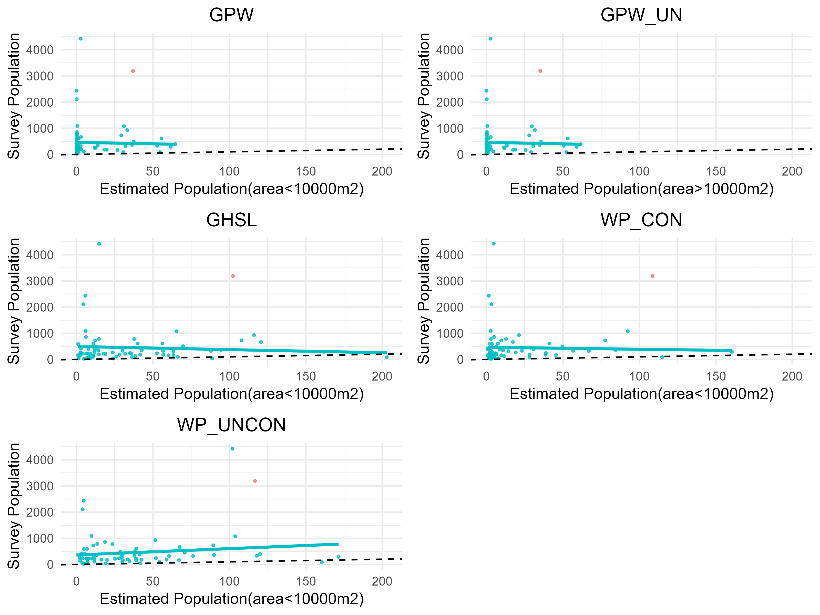
Number of Camps with area<10000m2: 69

Slide 28

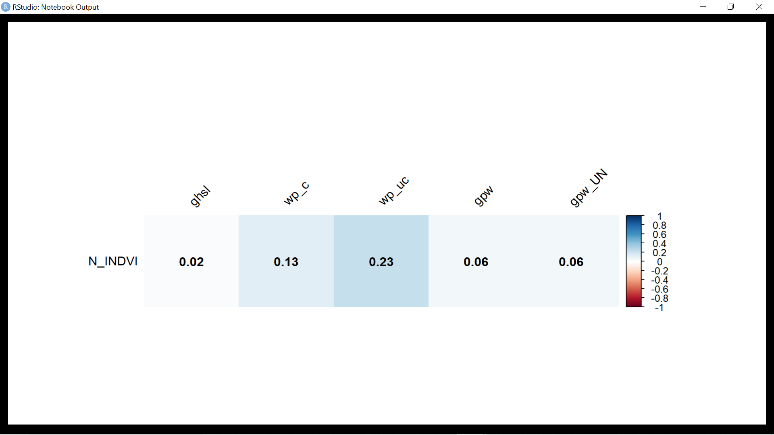
Correlation for the camps with area>10000m²
Number of Camps with area>10000m2: 154
Number of Camps with area<10000m2: 69
Correlation for the camps with area<10000m²

Slide 29
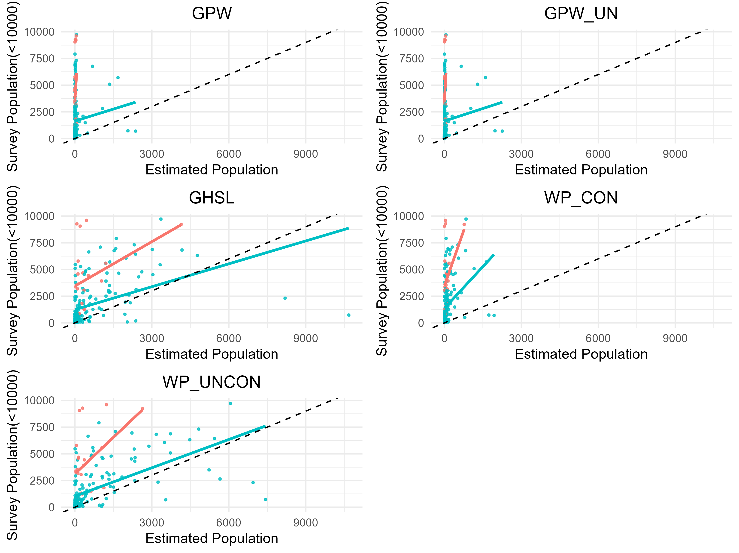
Number of Camps with population<10000 :24

Slide 30
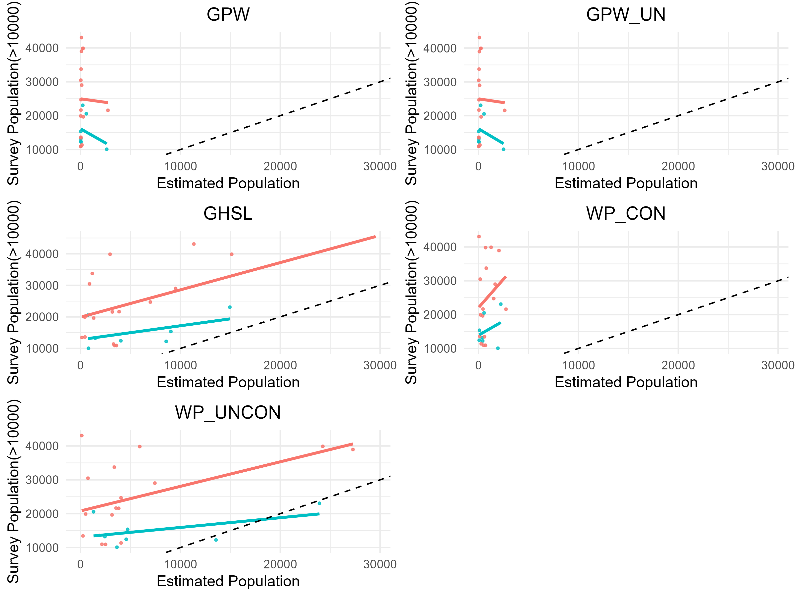
Number of Camps with population>10000 :199

Slide 31
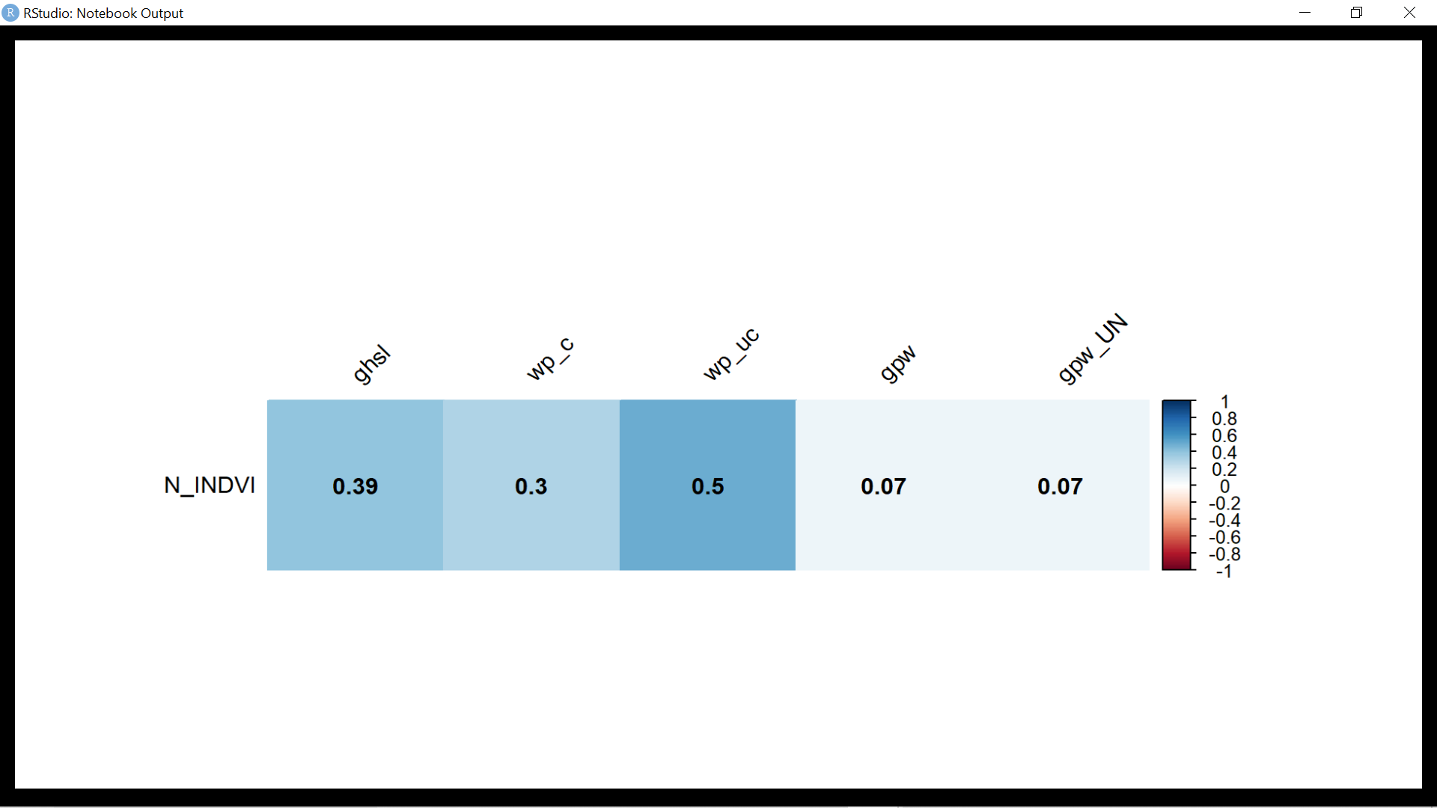
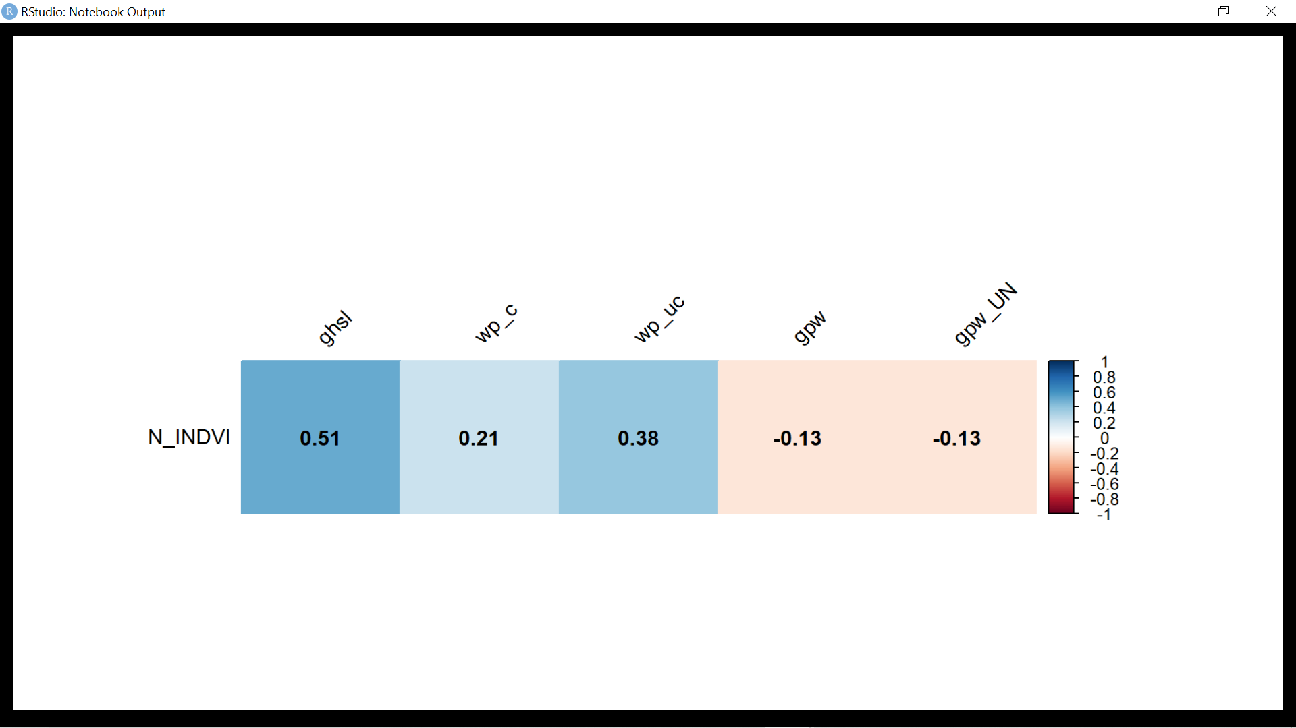
Correlation for population less than 10000
Correlation for population greater than 10000
Number of Camps with population<10000 :24
Number of Camps with population>10000 :199

Slide 32
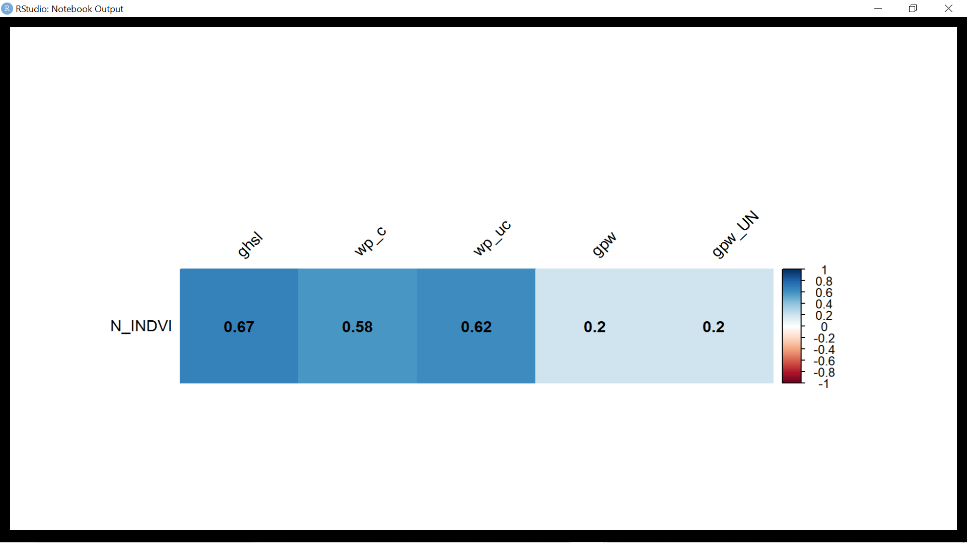

Formal Camps correlation of estimated population with surveyed population
Formal camps: 38
Informal camps:185
InFormal Camps correlation of estimated population with surveyed population

Slide 33
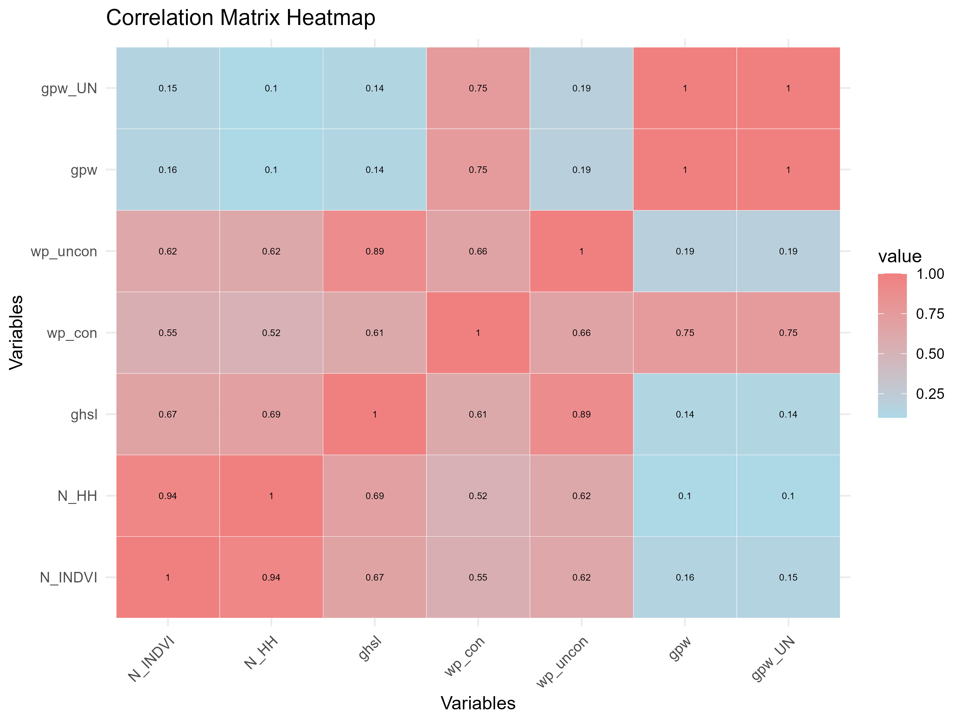
N_INDVI: Survey population
N_HH:Survey household number
ghsl: Estimated ghsl population
wp_con: Estimated world pop constrained population
wp_uncon:Estimated world pop unconstrained population
gpw: Estimated gpw population
gpw_UN: Estimated gpw UN census adjusted population
Notes:
N_INDVI (Survey Population):
Strong positive correlation with ghsl (0.67), indicating that areas with higher surveyed population tend to have higher estimated population according to the Global Human Settlement Layer (GHSL).
Moderate positive correlation with wp_con (0.63) and wp_uncon (0.55), suggesting that areas with higher surveyed population (N_INDVI) also tend to have higher estimated world population, both constrained and unconstrained.
GHSL (Global Human Settlement Layer):
Strong positive correlation with N_INDVI (0.67), indicating that areas with higher estimated population according to GHSL tend to have higher surveyed population.
Strong positive correlation with wp_con (0.89) and wp_uncon (0.61), suggesting that areas with higher estimated population according to GHSL also tend to have higher estimated world population, both constrained and unconstrained.
WP_CON (World Population Constrained):
Moderate positive correlation with N_INDVI (0.63) and ghsl (0.89), indicating that areas with higher surveyed population and higher estimated population according to GHSL also tend to have higher estimated world population (constrained).
Strong positive correlation with wp_uncon (0.66), suggesting that areas with higher estimated world population (unconstrained) tend to have higher estimated world population (constrained).
WP_UNCON (World Population Unconstrained):
Moderate positive correlation with N_INDVI (0.55) and ghsl (0.61), indicating that areas with higher surveyed population and higher estimated population according to GHSL also tend to have higher estimated world population (unconstrained).
Strong positive correlation with wp_con (0.66), suggesting that areas with higher estimated world population (constrained) tend to have higher estimated world population (unconstrained).
GPW (Gridded Population of the World):
Weak positive correlation with N_INDVI (0.16) and ghsl (0.14), suggesting a limited relationship between GPW and surveyed population or estimated population according to GHSL.
Weak positive correlation with wp_con (0.20) and wp_uncon (0.75), indicating a slight association with estimated world population, especially in unconstrained conditions.
GPW_UN (Gridded Population of the World Unconstrained):
Weak positive correlation with N_INDVI (0.16) and ghsl (0.14), similar to GPW, indicating a limited relationship with surveyed population or estimated population according to GHSL.
Strong positive correlation with wp_con (0.20) and wp_uncon (0.75), similar to GPW, suggesting a notable association with estimated world population, particularly in unconstrained conditions.

Slide 34
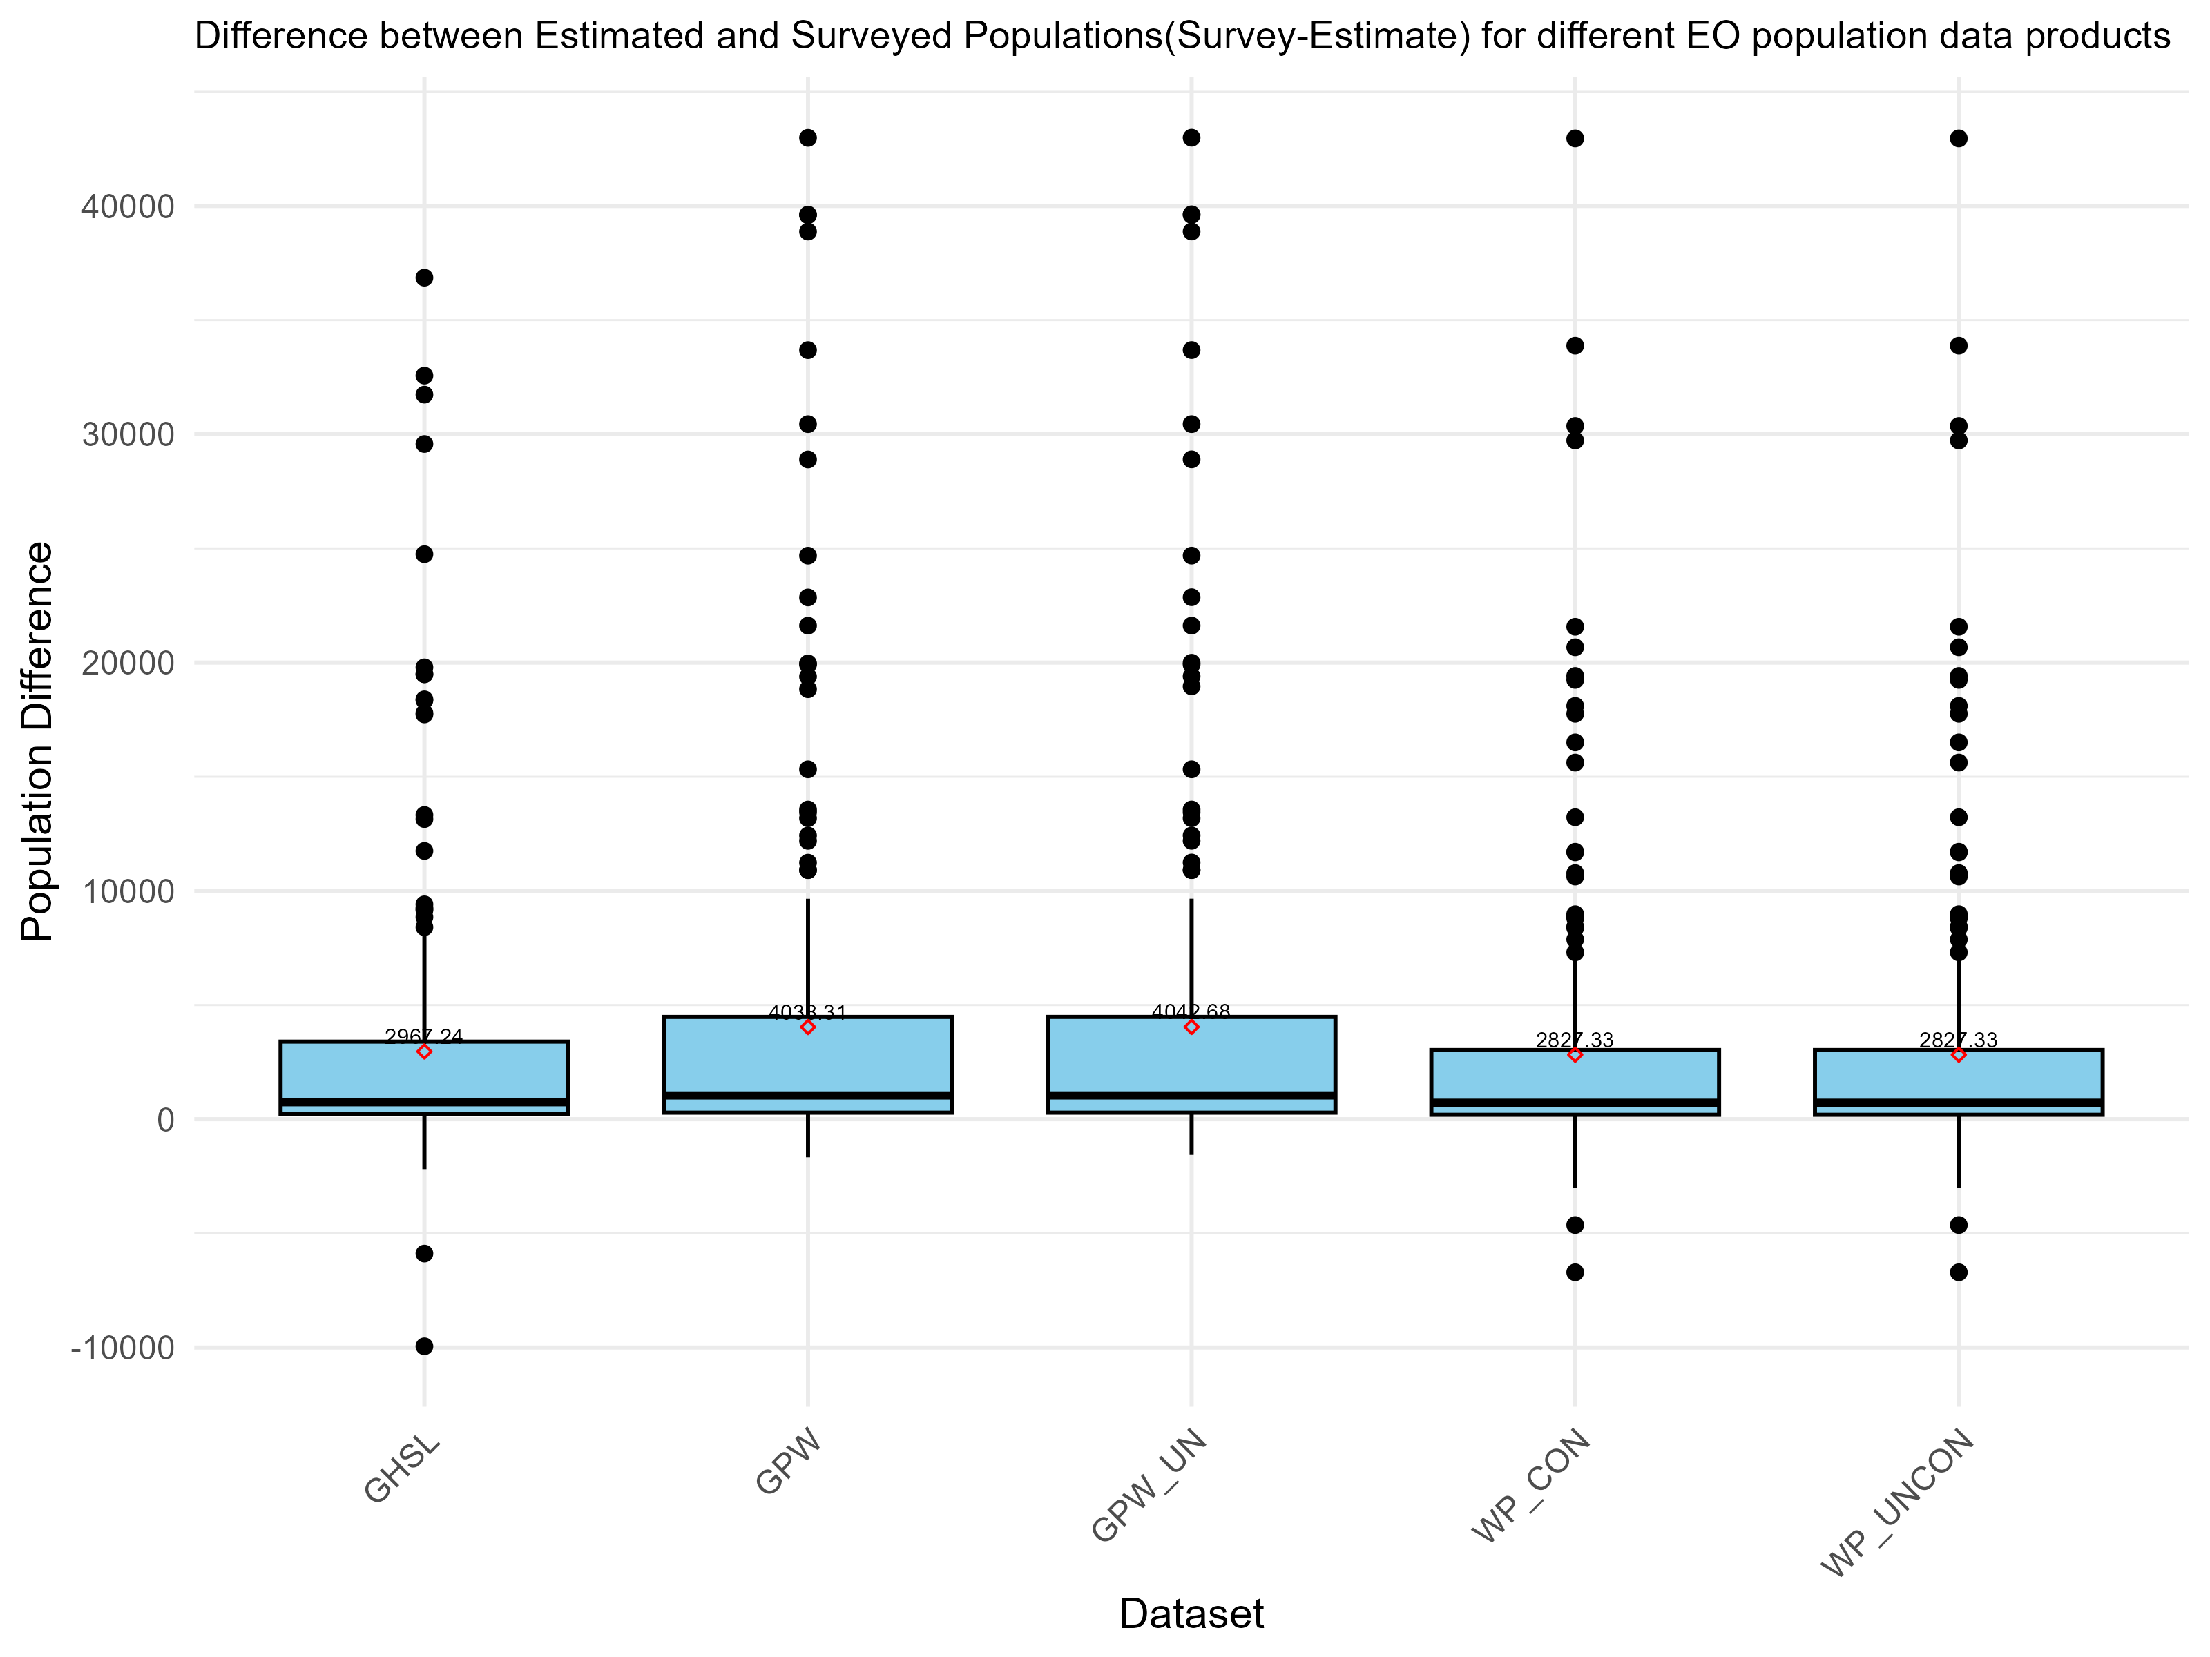
Notes:
survey-estimate

Slide 35
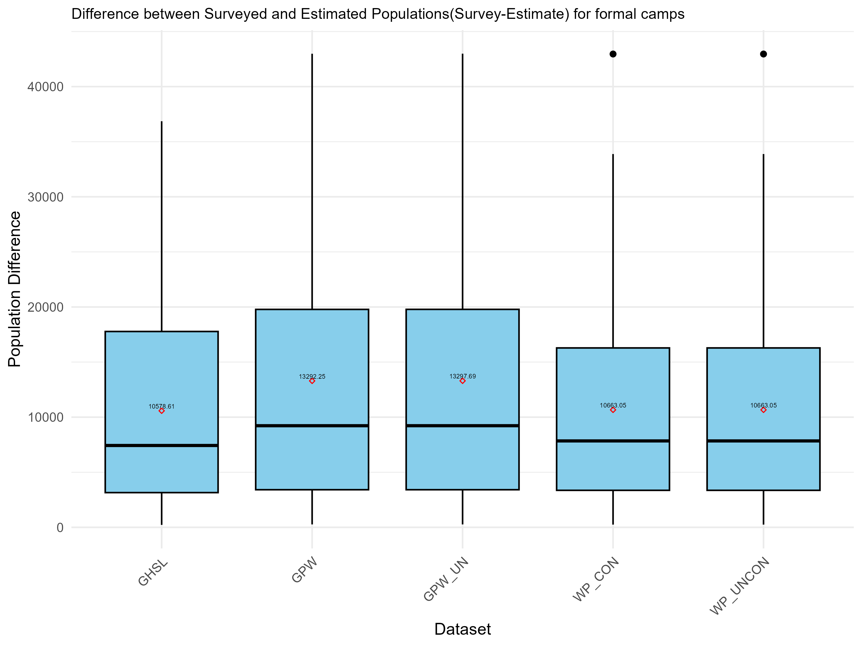

Slide 36
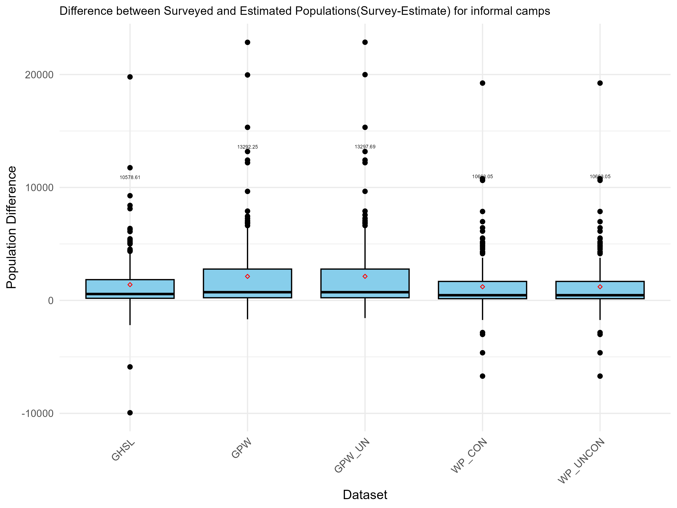

Slide 37
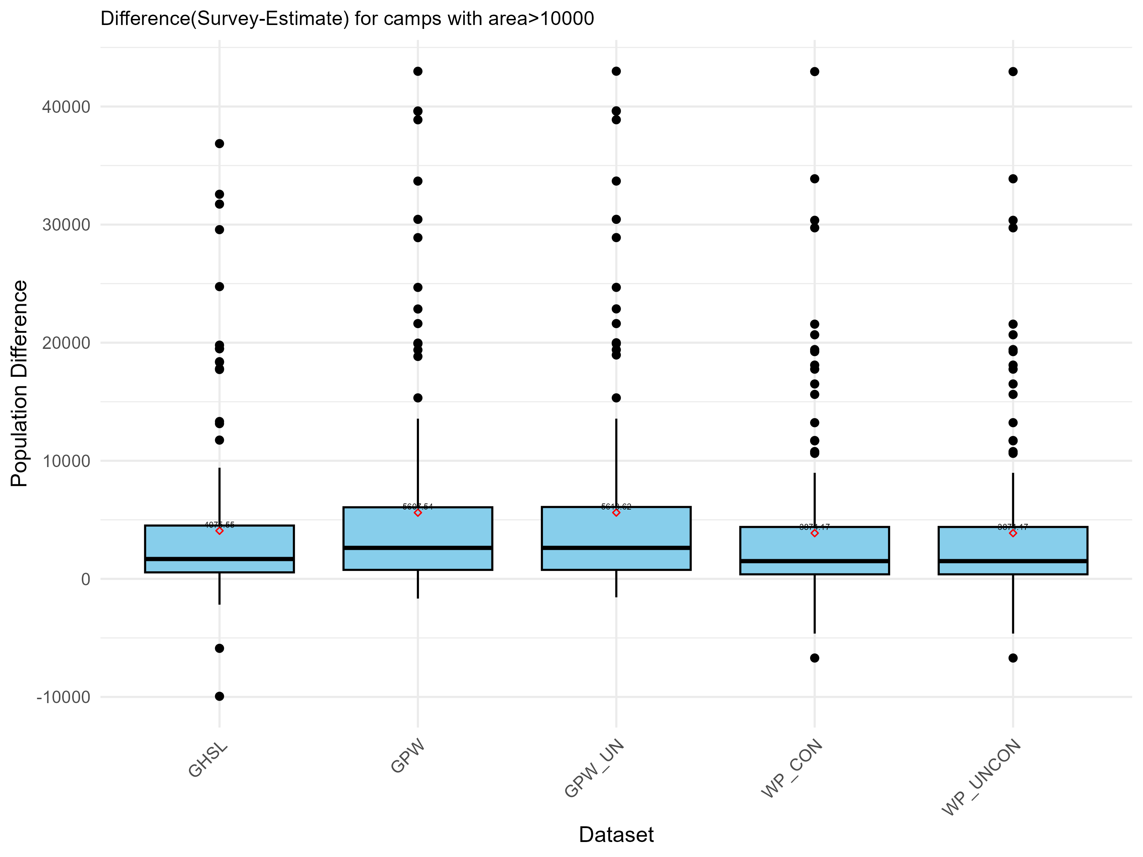

Slide 38
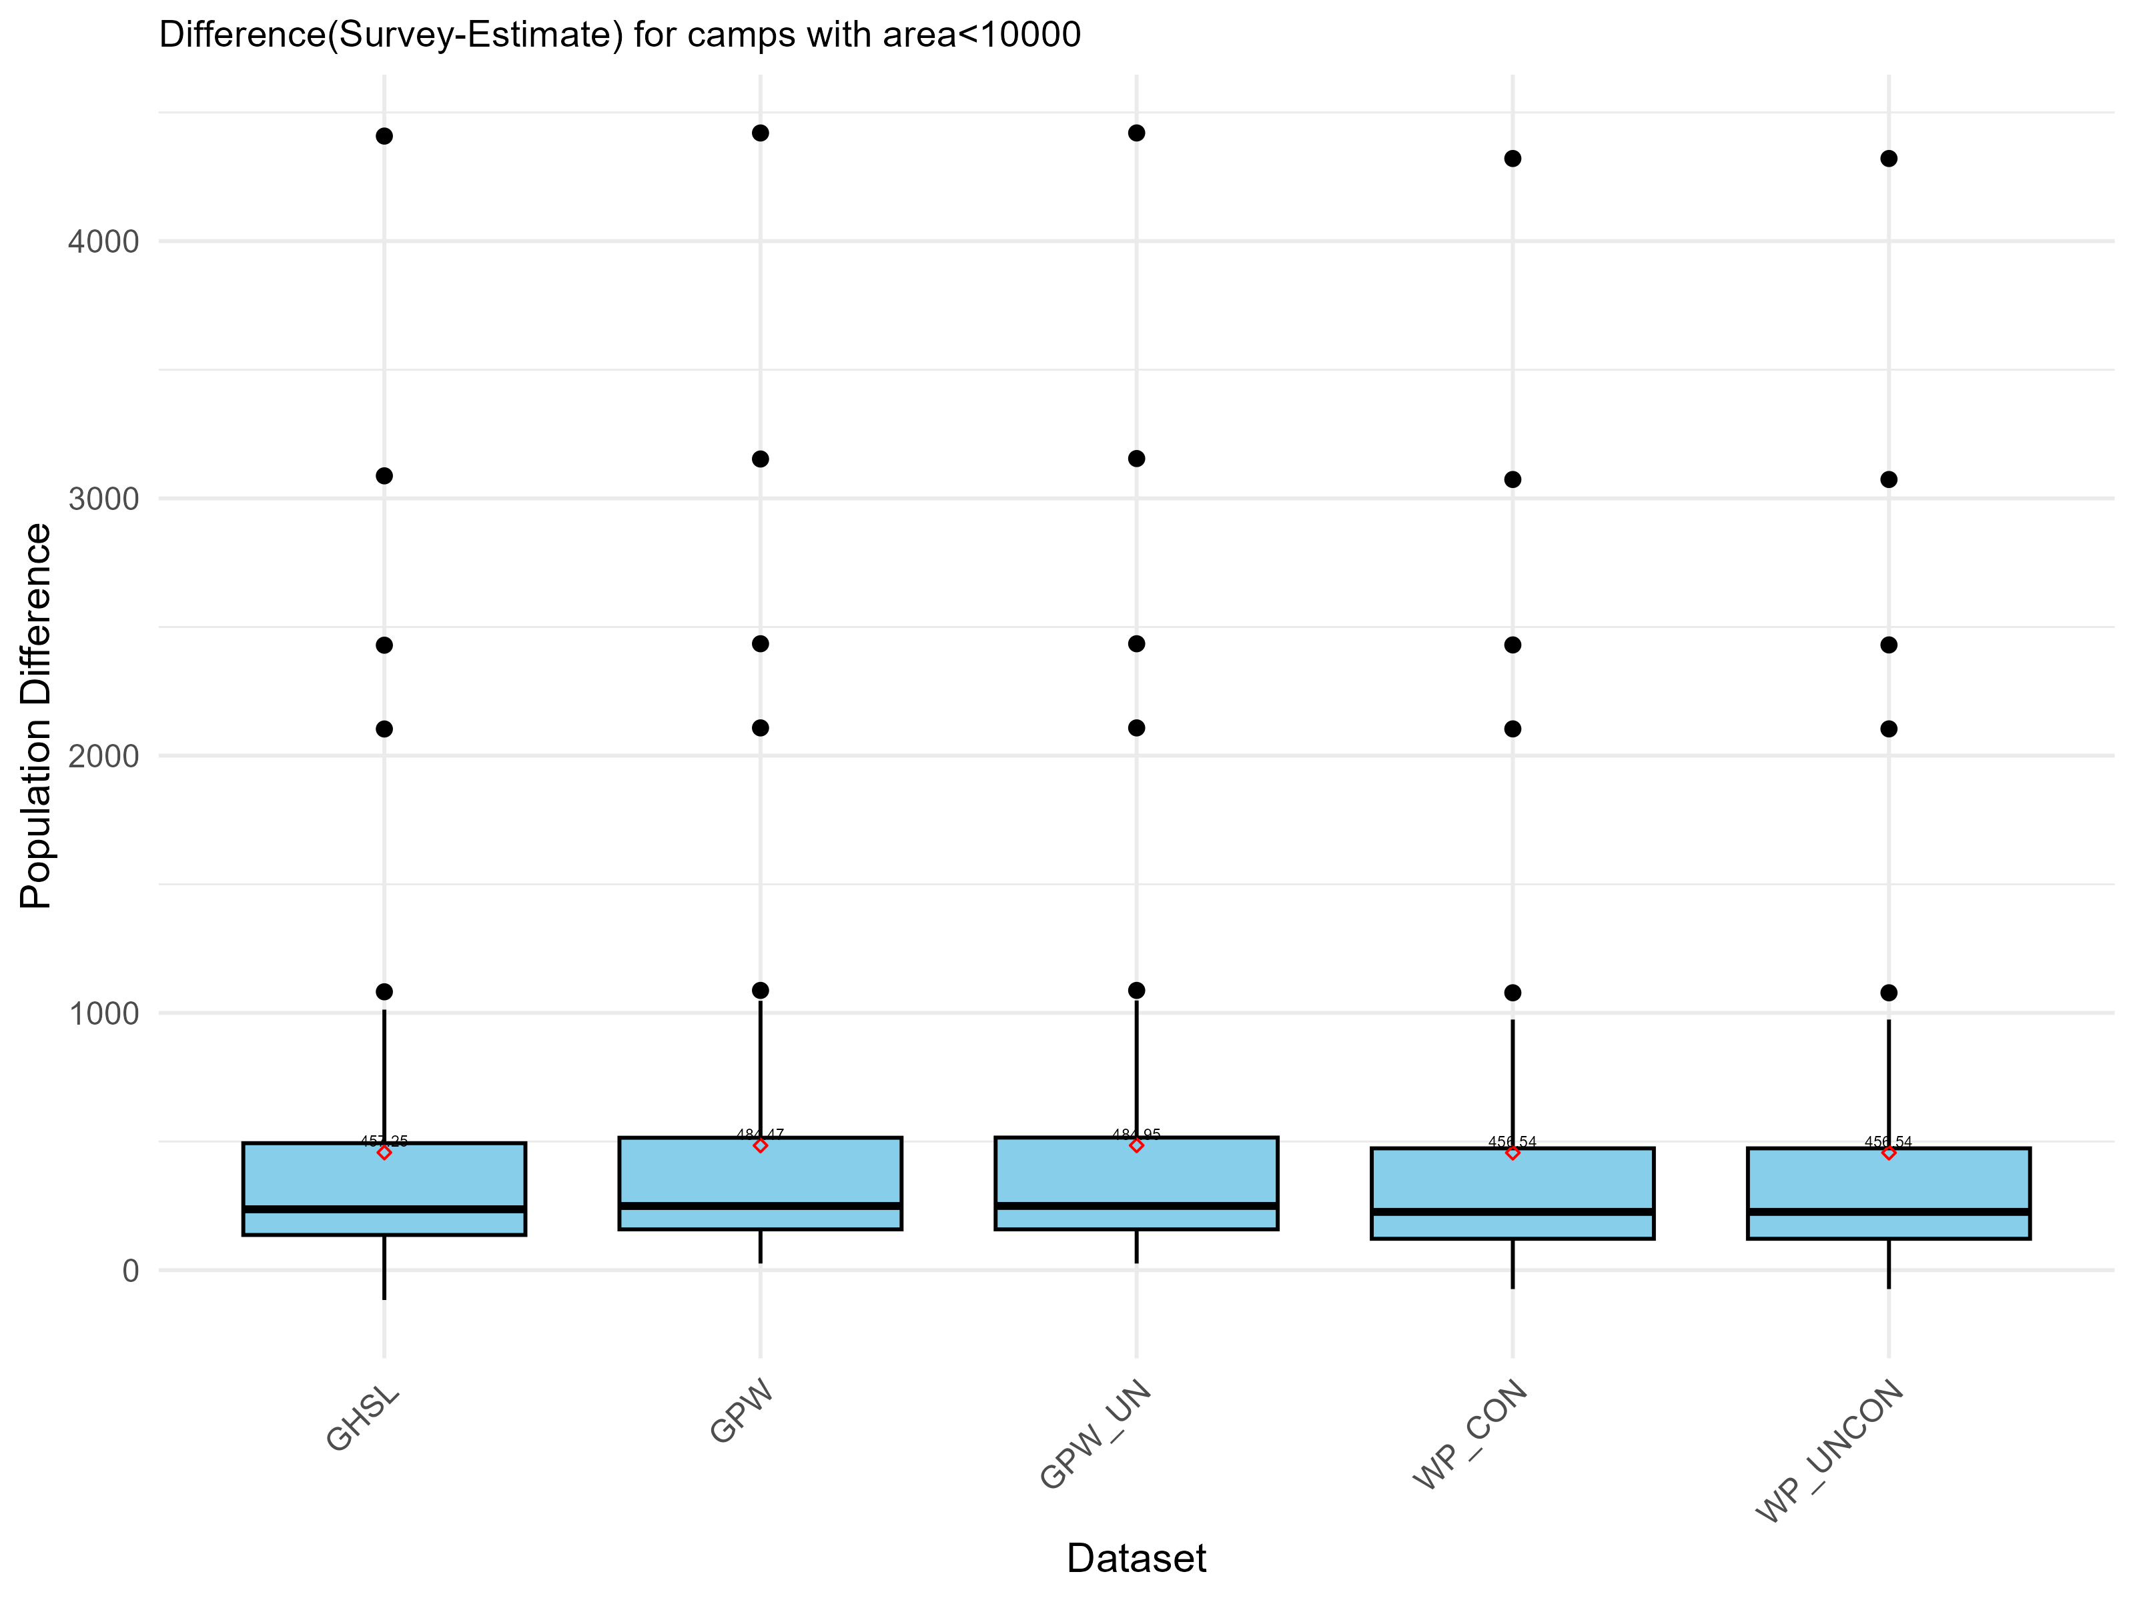

Slide 39
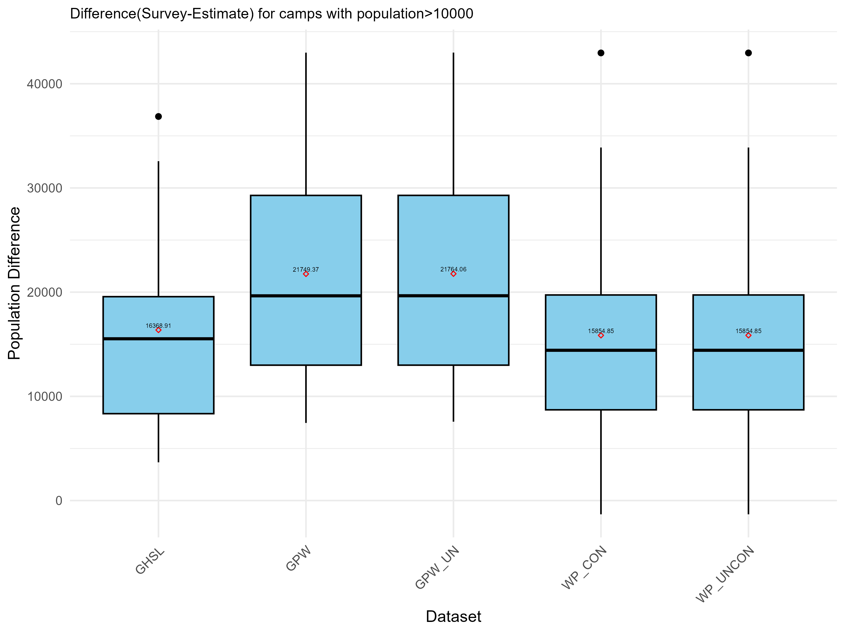

Slide 40
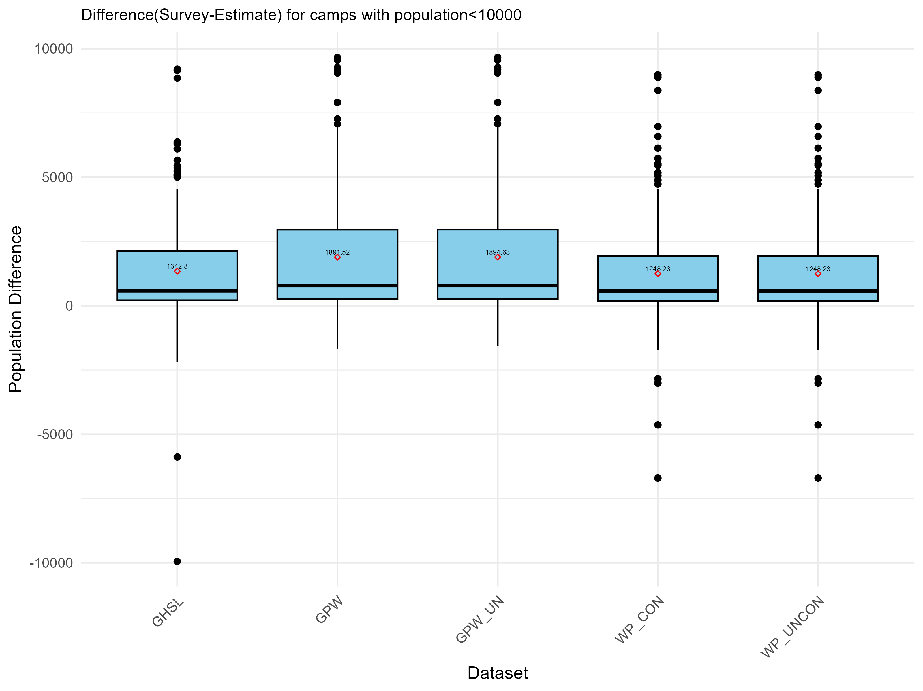

Slide 41
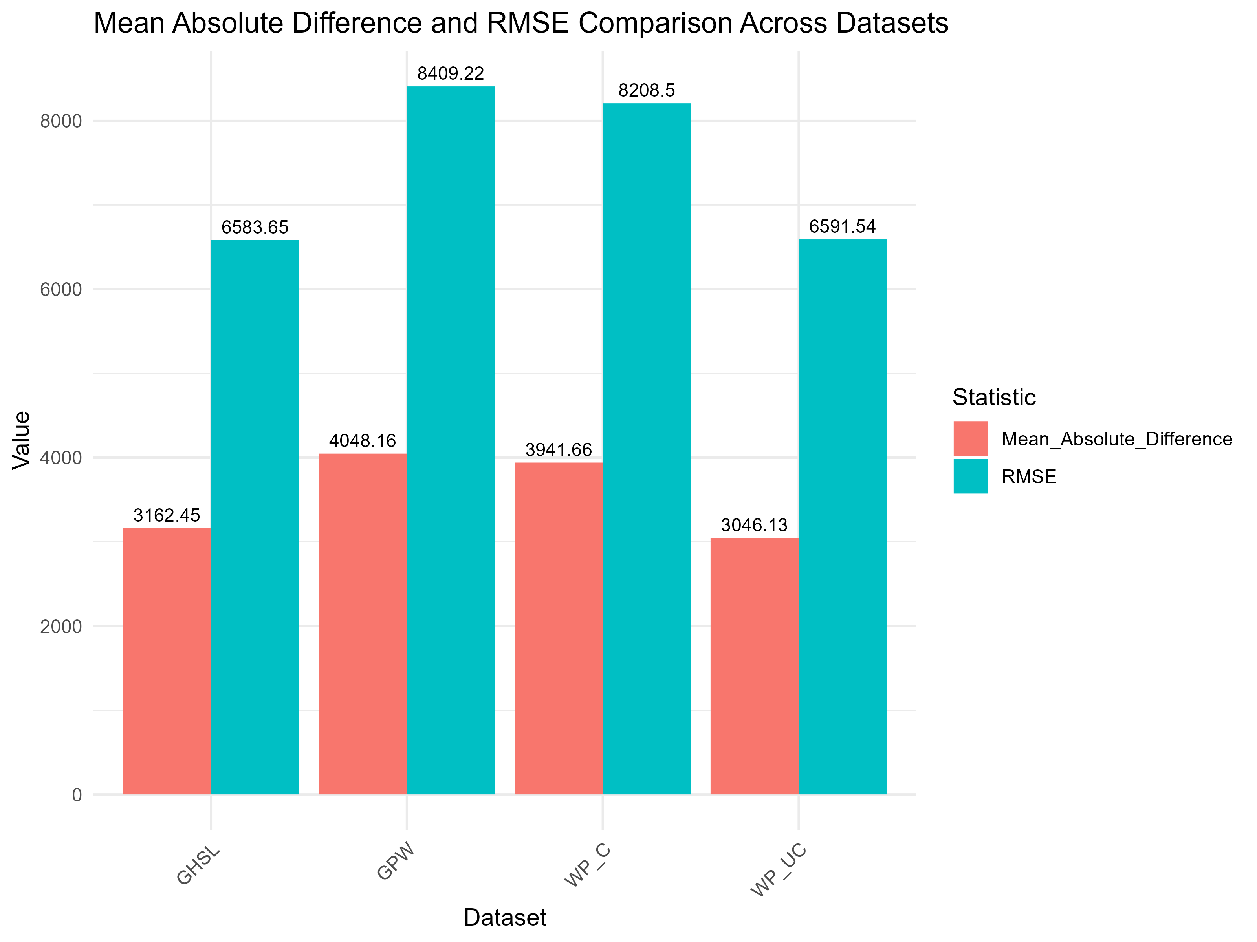

Slide 42
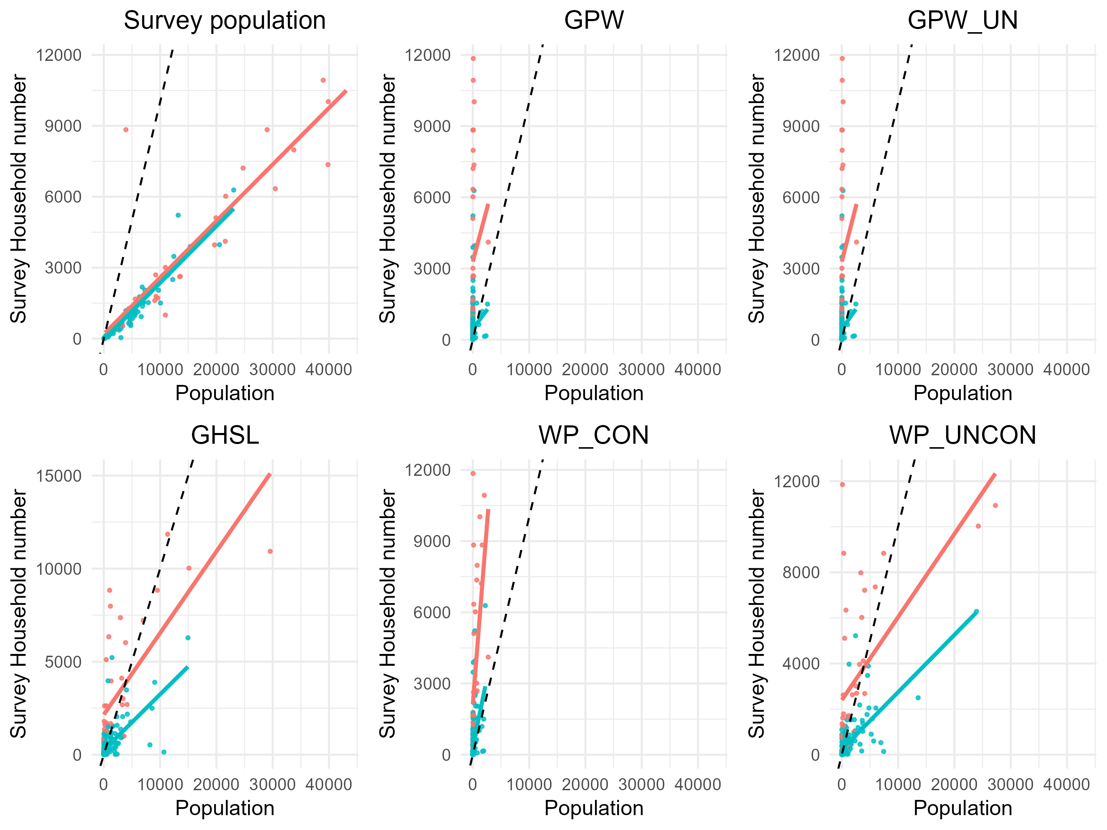

Slide 43
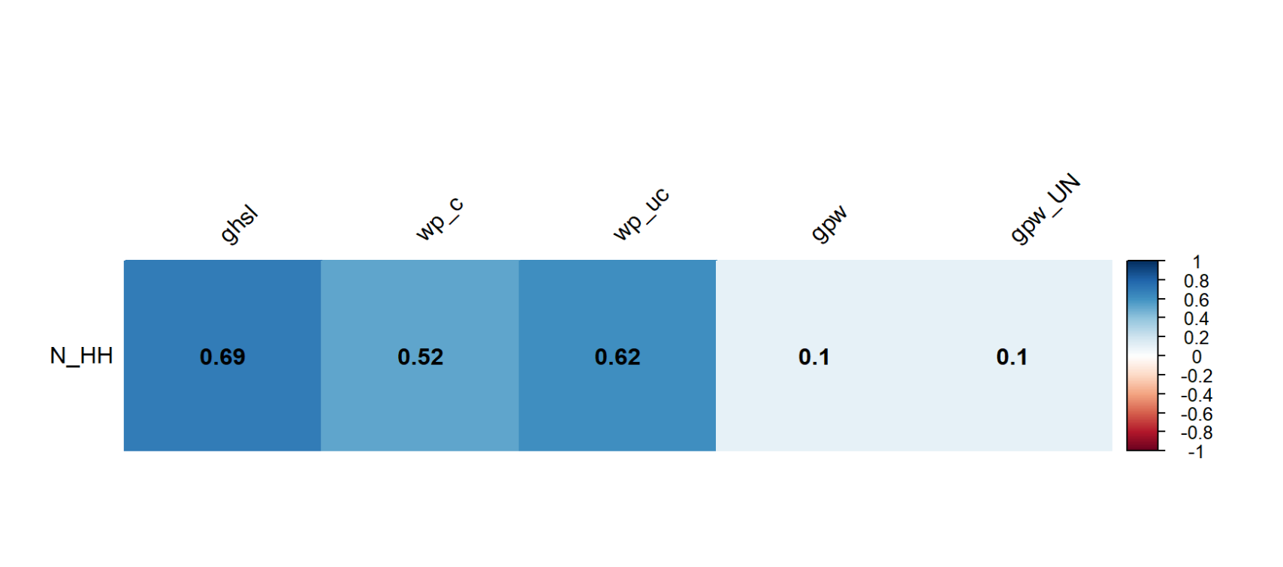

Slide 44
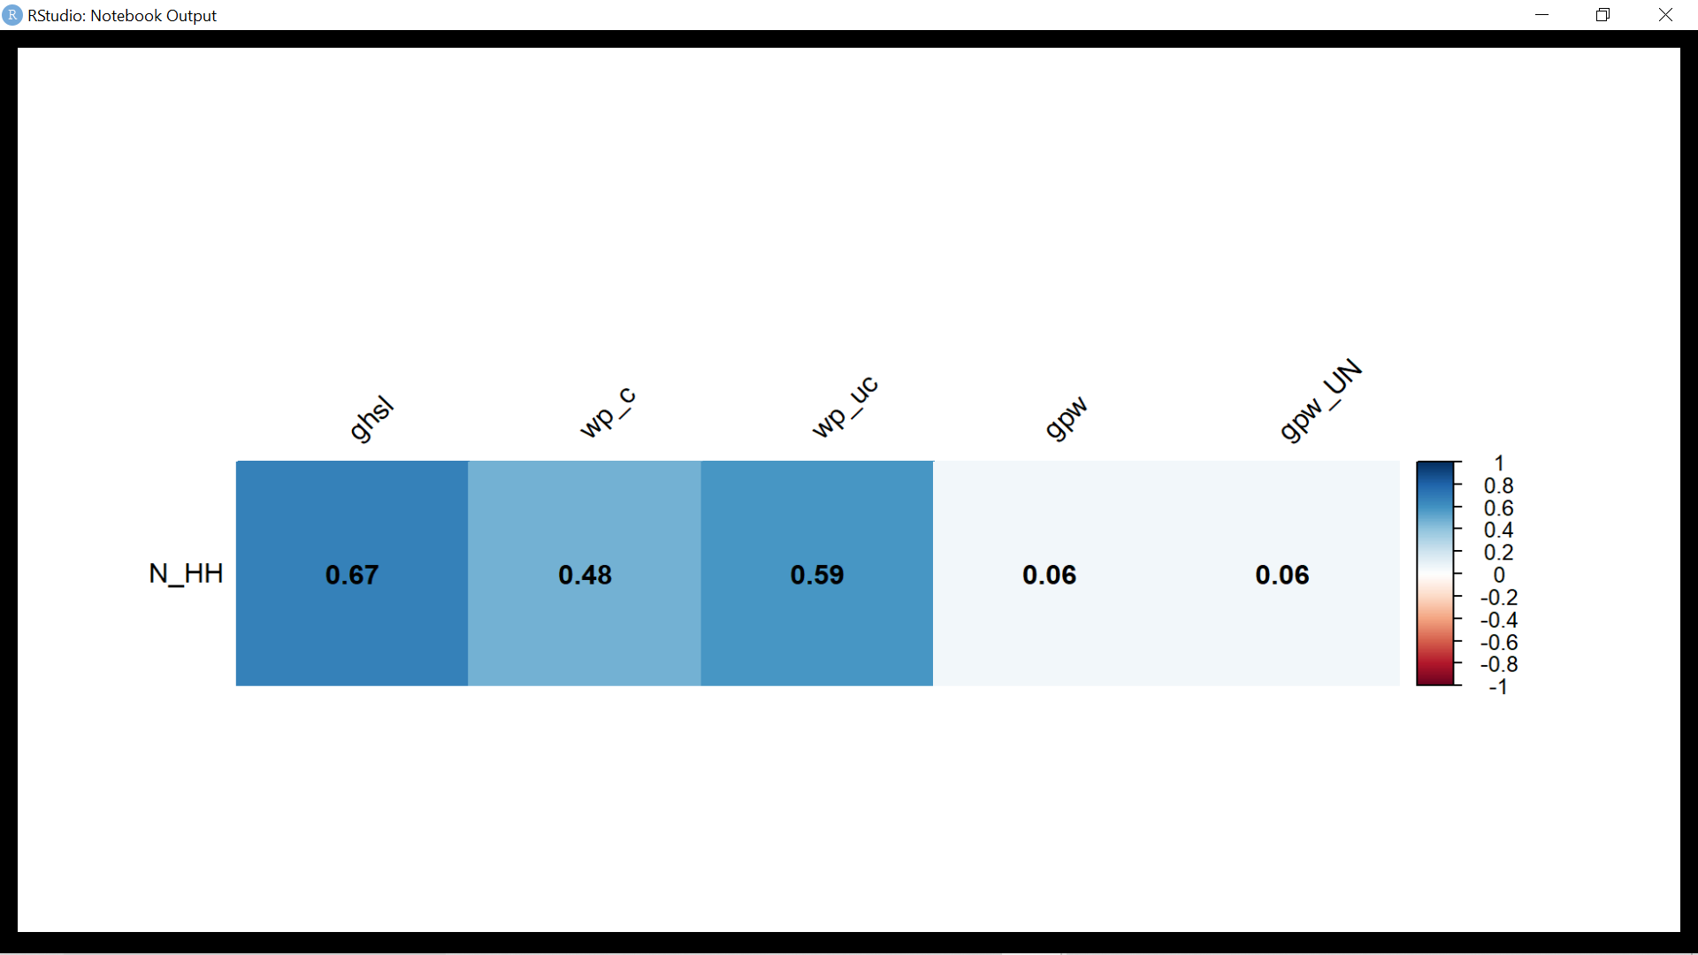
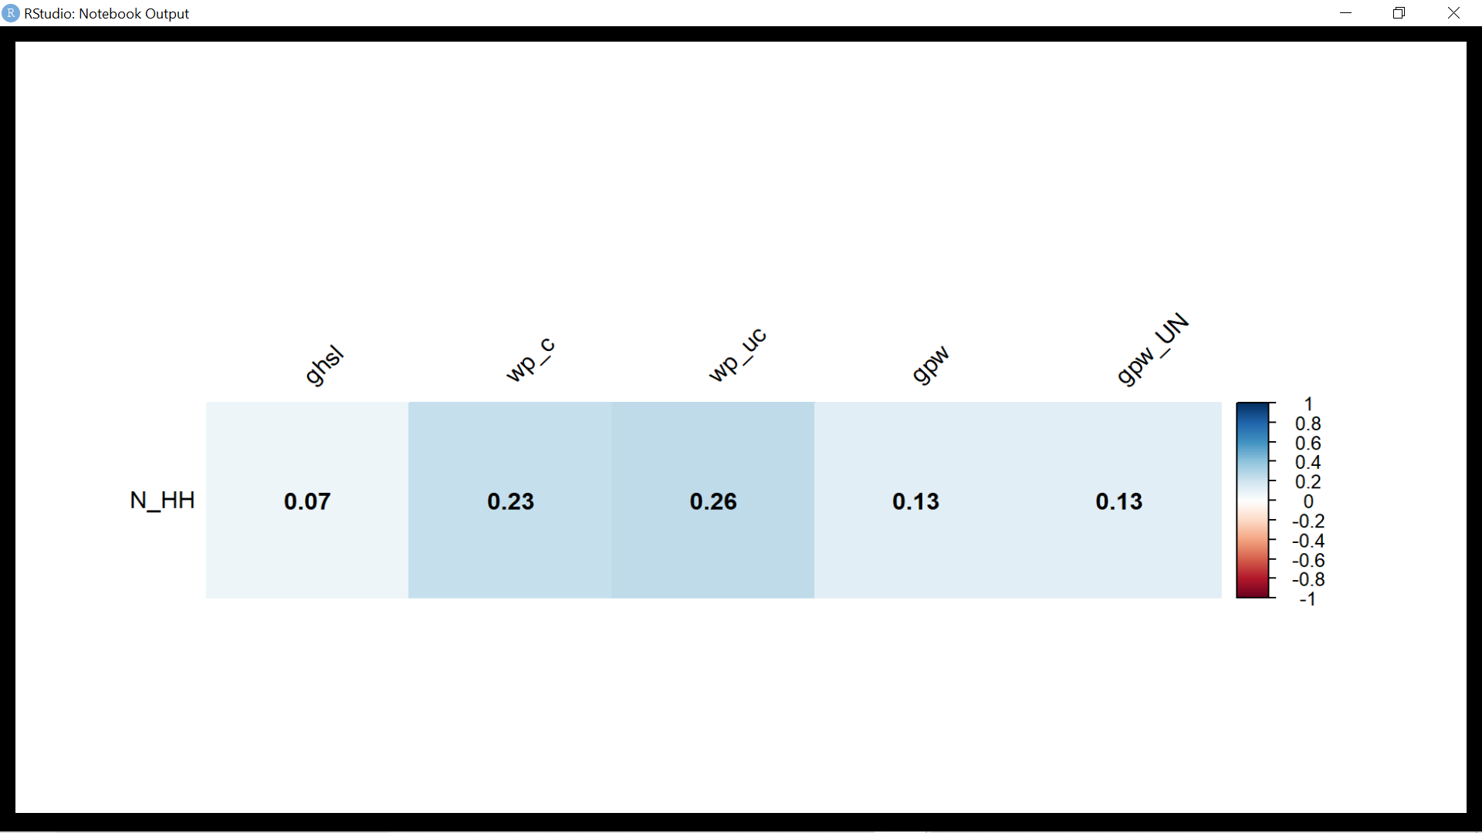
Correlation for the camps with area>10000m²
Correlation for the camps with area<10000m²

Slide 45
Correlation for population greater than 10000
Correlation for population greater than 10000

Slide 46

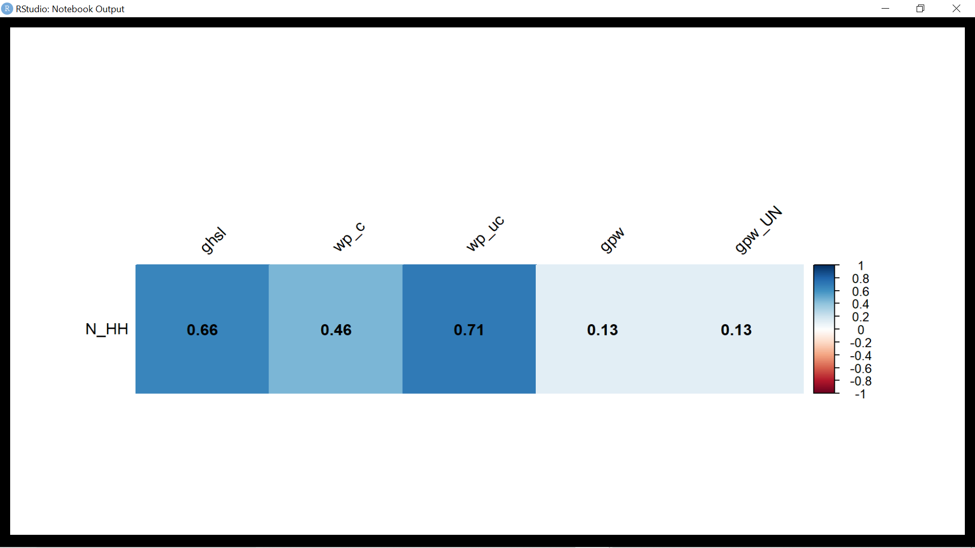
Formal Camps correlation of estimated population with surveyed household number
Informal Camps correlation of estimated population with surveyed household number

Slide 47

Microsoft Building footprint data
Nigeria :36 Million buildings
Derived method: ML automated feature extraction on satellite Imagery
Satellite Imagery during :Maxar imagery (2020−2021)

Slide 48


Building extraction 2 stages:
1. Semantic Segmentation – Recognizing building pixels on an aerial image using deep neural networks (DNNs)
2. Polygonization – Converting building pixel detections into polygons

Slide 49




Slide 50


Slide 51

Google Buildings
The dataset contains 1.8 billion building detections, across an inference area of 58M km2 within Africa, South Asia, South-East Asia, Latin America and the Caribbean.
Derived: Automated feature extraction from satellite imagery
Satellite Imagery during : Maxar imagery (2020−2021)Kenya &nigeria (2021 release)

Slide 52

Google-Microsoft Open Buildings - combined by VIDA
Merges Google's V3 Open Buildings and Microsoft's latest Building Footprints. With 2,534,595,270 footprints
It covers 92% of Level 0 administrative boundaries, and is divided into 182 partitions

Slide 53

OSM
Global, but sub-national coverage varies
-
Data extracted from OSM on 13 October 2022
Predominantly manual digitization from satellite imagery, aided by some automated feature detection
-
Imagery from various sources

Slide 54


Slide 55


Slide 57


Slide 58


Slide 59


Slide 60


Slide 61


Slide 62


Slide 66


Slide 67


Slide 68


Slide 69


Slide 70


Slide 71


Slide 72


Slide 73
Metrics used to compare the building dataset for the refugee camps.
Building count
Building area
Building density calculated from count and area

Slide 74

Camp with more population and less area
KIRENUWA CAMP(BO_S294 )
Site population:224
Official Site area: 334.61m²
Calculates site area:342.7668 m²

Slide 75

B0_S110_BANKI CAMP-Highest Individuals

Slide 76


Slide 77


Slide 78


Slide 79


Slide 80


Slide 81

Notes:
highest outlier for the formal camp is 1 BO_S110 pop- 43074 cal-area 528083.3 site-area503339.8

Slide 82


Slide 83


Slide 84


Slide 85


Slide 86


Slide 87


Slide 88


Slide 89


Slide 90


Slide 91


Slide 92


Slide 93


Slide 94


Slide 95


